Slide 1
Junior Class of 2025 Counselor Meeting

Slide 2
Graduation Requirements
Understanding Academic Recommendations for Next School Year
Special Programs
Work-Based Learning
Early Graduation
Minimum Day
0 - Period
Elective Registration
Mental Health Resources
Bridge Bill
Health Survey

Slide 3
Graduation Requirements
Students must complete and pass 23 classes to graduate per the Georgia Department of Education. These credits must be earned in specific subject areas.
4 credits in English
4 credits in Math
4 credits in Science
3 credits in Social Studies
1 Personal Fitness and Health or 3 credits in JROTC
3 credits in CTAE/Fine Arts/World Language
4 Electives

Slide 4
Understanding Academic Registration
Each semester, your teachers make course selections for you based on how you performed in their classes that semester.
For fall semester, this was done at the end of the semester. For this semester, teachers have already made these selections.
Many times, teachers will have discussions with the students about their recommended placement.
Please take an active role in your education by asking questions. You and your parents/guardians will be able to view your recommended courses in your Academic Planner on Infinite Campus in April. Your academics should not be a surprise in August when you get your schedule.
In April, you may request changes by communicating with your Counselor.
All changes need to be made by the end of April so we can allot for our teachers and classes for next school year.

Slide 5
Academic Registration
Students will typically take the following academic classes for 12th grade year:
English: Multicultural Literature, Honors Multicultural Literature, or AP Literature. Students who have earned 4 credits in English may take Advanced Composition, Dramatic Writing (embedded course is Advanced Composition), or select to not take an English course their senior year.
Math: Pre-Calculus, Honors Pre-Calculus or Statistical Reasoning. Students who have completed their 4 math credits may take AP Statistics or AP Calculus.
Science: Forensic Science, Zoology, Honors Zoology, AP Biology, Honors Chemistry/AP Chemistry (year-long), AP Physics, or Honors Anatomy (must have not taken Essentials of Healthcare).Students who have completed their 4 science graduation requirements, may elect to not take a science.
Social Studies: Economics & Government, Honors Econ & Government. AP Government (taken in one semester), and AP Microeconomics (taken in one semester) AP Social Studies courses count as 2 separate credits, but both Economics and Government course are required to graduate.
As a reminder, if you failed a course required to graduate, you will need to take the failed course in summer school (more information to come) or you will need to take it next school year and double up in that subject area.

Slide 6
Honors/AP
Students who take an Honors course earn 5 additional bonus points on their final grade when passed with a 70 or higher.
Students who take an AP course earn 10 additional bonus points on their final grade when passed with a 70 or higher.
As a reminder – the HOPE program removes bonus points awarded.
If you want to take an Honors or AP course, and your teacher did not recommend you for the course – please see a counselor to complete an Honors/AP waiver.
If your teacher recommends Honors/AP and you do not want to take this level, you need to let your counselor know before the end of April for scheduling reasons.
There is no guarantee you may drop your Honors or AP course if the on-level course is full come August. Please select your academics and electives wisely.

Slide 7
Academic Planner
As mentioned in a previous slide, students will review their courses to ensure the academics and electives that are entered in their academic planner are correct.
Counselors will email parents when all registration has been completed. During this time, students and parents must review this information. Counselors will also send out reminders to students through Canvas to check their academic planner. Be sure you are reviewing these messages.
Students will not be able to make a change to the academic planner through Infinite Campus. You will need to email your assigned high school counselor and request a change be made.
Again, all changes must be completed come end of April 2024.
Helpful Hint: Add a reminder to your calendar and set a notification to check your academic planner by April 10th.

Slide 8
Athletics
Students are offered the opportunity to play a sport in high school. Each high school has various sports students may try out for. Be sure to contact the head coach of each sport and ask about conditioning and tryout information.
Some teams begin conditioning in the summer.
Students will need a physical on file with North Paulding High School to participate in workouts, conditioning, and tryouts.
Did you know…
To play sports in high school students must earn 2.5 credits each semester to be eligible to play. This is a Georgia High School Association (GHSA) guideline that is followed by all Georgia high schools.
Also, students must be on-track to graduate and in their cohort grade level

Slide 9
GA Futures
Gafutures is the website you will use to monitor your Hope GPA. At the end of each semester, when final grades are posted to your transcript, students will be able to log into their GA Futures account and view their HOPE GPA.
Students will create this account on their own. They will need to enter their legal information including their social security number to display the HOPE GPA.
Ga Futures is your go to website to learn all about the HOPE scholarship, look for scholarships, apply to colleges, and so much more!
www.Gafutures.org

Slide 10
HOPE Scholarship
The HOPE Scholarship is an opportunity for students to earn tuition toward college courses after they graduate from high school.
The HOPE scholarship can be applied to four-year and two-year colleges, as well as private colleges. Students must attend a Georgia college for funding availability.
The HOPE GPA (grade point average) and your high school GPA are NOT the same!
The Hope Scholarship only calculates your GPA for core courses and World Language (English, Math, Science, Social Studies, and World Language).
By law, the HOPE GPA does not round
If a student takes an honors course, the 5 additional bonus points are removed for the students HOPE GPA calculation.
If a student takes an AP course, the 10 additional bonus points are removed for the students HOPE GPA calculation. However, the Hope program does award .5 points back to the HOPE GPA calculation for AP courses only.
High School courses taken in middle school are not calculated in a students HOPE GPA.
Student will be able to view their HOPE GPA through their GA Futures account. Students should have created their own GA Futures account.

Slide 11
HOPE Scholarship Cont.
Qualifications for HOPE (covers a portion of your public or private college tuition):
3.0 HOPE GPA
4 Rigor Courses
No SAT or ACT requirement to receive HOPE
Qualifications for Zell Miller Scholarship (covers 100% college tuition for a public college, and a portion for private college)
3.7 HOPE GPA
4 Rigor Courses
SAT Score -1200 (composite)
ACT Score - 25 (composite)
Students should check to ensure their SAT/ACT scores have been submitted to their
GAFutures account to qualify for the Zell Miller Scholarship.
Please visit the GA Futures website to learn more about the Hope Scholarship
WWW.GAFUTURES.ORG

Slide 12
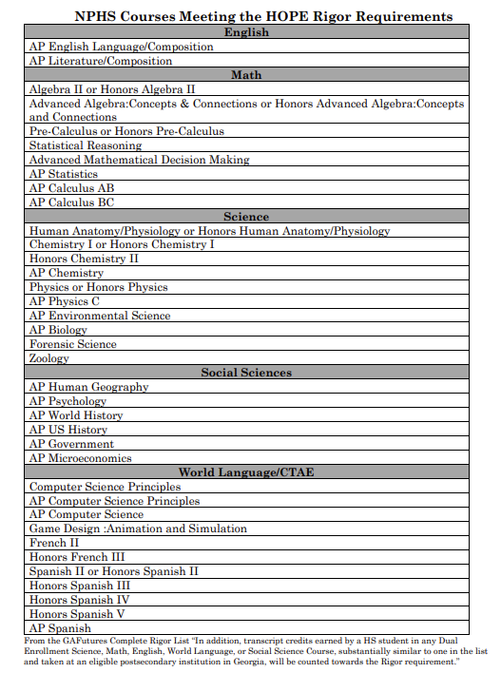
The courses listed on this slide are current NPHS classes that are considered rigor with GA Futures.
To view the full list of all rigor courses students should visit the GaFutures website:
https://www.gafutures.org/media/4wsjm2ej/rigor-list-september-2023-print-ready-10032023.pdf

Slide 13
End-of-Course Assessment (EOC)
EOC’s are end of course assessments that will count for 20% of a student's final grade. These are state mandated tests.
Courses with EOC’s are Algebra I, Biology, American Literature, and US History.
EOC’s cannot be exempted, unlike teacher finals.

Slide 14
SAT and ACT
Some Georgia colleges will continue the temporary waiver of test score requirements for the Fall 2024, Spring 2025, and Summer 2025 admissions requirements.
Students will need to research the college they are interested in attending to see if they qualify for the test waiver based on their GPA. This information can be found here:
https://www.usg.edu/announcements/usg_to_extend_temporary_test_optional_admission_for_academic_year_2024_2025
If you do not meet the requirements for the test waiver or will be attending a college out of state that does not allow test waiver options, you will need to register for the SAT or ACT.

Slide 15
SAT and ACT
Students register for the SAT by visiting the website www.collegeboard.org
Students register for the ACT by visiting the website www.act.org
Students who receive free or reduced lunches qualify to take the SAT and/or ACT free two times. You must see your assigned school counselor to receive further instruction.
An SAT and ACT comparison chart and study materials are found on our counseling website under the SAT and ACT tab’s

Slide 16
College Visits
As a junior, we highly encourage students to begin visiting colleges. This can be done by scheduling a campus tour through most college websites. By taking a college tour this will allow students to view the campus facilities, view dorm rooms, review tuition fees, learn about special programs, find dining information, and much more.
We also encourage students to attend probe fairs which are advertised throughout the year by our counseling department. Probe fairs allows a student to talk to college admission representatives and review program options in one central location.

Slide 17
Senior Information
At the beginning of your senior year, counselors will be working with students to complete a senior letter. This document will contain important information including Hope scholarship requirements, courses required to meet graduation requirements, EOC information, and more!
Rising seniors will need to schedule their senior pictures starting this summer. Your parent will receive information on how to book these sessions with Cady Studios. Please be sure to book your senior picture to ensure you are in the yearbook.

Slide 18
Special Programs
Available through Paulding County School District and North Paulding High School

Slide 19
Paulding College and Career Academy (PCCA)
Pathways Offered
Healthcare
Dual Enrollment Opportunities
Certified Nursing Assistant & Certified Medical Assistant
Patient Care Technician Opportunity
Mechatronics/Manufacturing
Electronics, Computers/drafting, Robotics
Dual Enrollment Opportunities
Energy
Lineman/Technician
Cybersecurity
Dual Enrollment Opportunities
IT
DELL Certificate
Serves all 5 high schools in Paulding County.
Programs are housed at New Hope Education Center
Transportation is provided to and from NPHS for classes.
Offers courses and pathways specifically selected based upon the work needs of the surrounding area and the state.
Let your counselor know via email if you are interested in attending PCCA for Fall 2024, before the last day of school.

Slide 20
Online Opportunities
Online at NPHS
Online at Home with Paulding Virtual Academy
Is there a course not offered at NPHS that you would like to take?
Did you fail a class and want to recover it online instead of in a class?
Would you prefer to take an online class during the school day in a lab setting?
These opportunities are available for you. Talk to your counselor about how to do this.
For a fully online experience while remaining a North Paulding student, applications for Paulding Virtual Academy will soon be provided to parents and students.
Please note that this is a yearlong commitment.
Students who want to take a new credit course online should complete the SB 289 application available in April on the PCSD website.

Slide 21
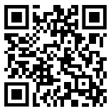
Work-Based Learning (Juniors and Seniors only)
Program available for students who have a job and would like to earn credit for working while also having an abbreviated high school schedule.
Students who work 7.5 hours a week qualify for 1 block of WBL. Students who work 15+ hours a week qualify for 2 periods of WBL.
Students MUST have a job by the start of the school year, and must have transportation, be on track for graduation, and have a good attendance record.
Junior students are not guaranteed a parking pass. Students may apply for the WBL program and will be approved based on parking availability.
Students interested in the Work-Based-Learning (WBL) program, will need to complete the application (scan QR code).
Due April 1, 2024

Slide 22
Dual Enrollment (Juniors & Seniors Only)
What is it?
What are the Benefits?
Students can take courses from a state public or private college while still enrolled as a high school student and receive credit both at the high school and at the postsecondary institution.
Most college classes (up to 30 hours) are free for high school students.
Expand course offerings
Save money on college.
Get ahead on college coursework.
Flexible schedule.
Quicker entry into the workforce.
Considerations
Deadlines for Fall of 2024 are usually early spring, so if you are interested, please review all requirements at www.gonphs.weebly.com, click on the Dual Enrollment Tab to read, and contact your counselor.
Maturity Level
Do you meet admission requirements?
Transportation (Dual Enrollment does not guarantee a parking pass.)

Slide 23
Early Graduation (Juniors and Seniors only)
Students have an option to graduate early from one of the following options:
Spring semester Junior Year
Fall Semester Senior Year
Students may still participate in prom and senior activities.
If you are considering applying for early graduation, talk with your parent/guardian and school counselor to review options.
Students must turn in a letter of intent to their school counselor by the last day of school (May 22, 2024)
Students can find the early graduation letter of intent and more about the early graduation program by visiting our counseling website and selecting “early graduation” or selecting this link: https://gonphs.weebly.com/early-graduation.html

Slide 24
Minimum Day (Seniors Only)
Senior students on track to graduate may apply for minimum Day
Students may have only one period of minimum day
AM Minimum Day (1st period) OR
PM Minimum Day (4th Period)
Students must have their own transportation
Keep in mind when choosing minimum day: athletics and after school activities
Minimum Day forms must be turned into the counseling office before the last day of school (May 22, 2024)
Minimum Day does not guarantee students a parking pass.

Slide 25
0 Period
0 period is from 7:30am to 8:30am. This option allows students to leave school a period earlier since they started the day earlier.
Students may combine this option with Minimum Day OR Work-Based Learning
Students must have their own transportation.
Course options include Statistical Reasoning and/or Economics/Personal Finance & American Government
A sample schedule is below of 0 period.
Scan this QR Code if interested in 0 period
(seniors only)

Slide 26
Elective Registration
Notes:
Online opportunities are available at NPHS as well as outside of NPHS. If you desire to attend school but want to take a course that is not offered, such as Japanese or Gothic Literature, you can! If you failed a course that needs to be recovered and desire to take it online instead of in a class, you can do that, too! Online classes are available for students to take during the school day in a lab setting. There is a Senate Bill 289 application required for some online classes. This will be available on the PCSD website April through June. If you are interested in this option or have questions, please talk to your counselor.
If you prefer to do classes fully online, outside of NPHS, you can do so with Paulding Virtual Academy. The application for this will be available on the Paulding County School District website in April. Please note that if you choose this option, it is a yearlong commitment.

Slide 27
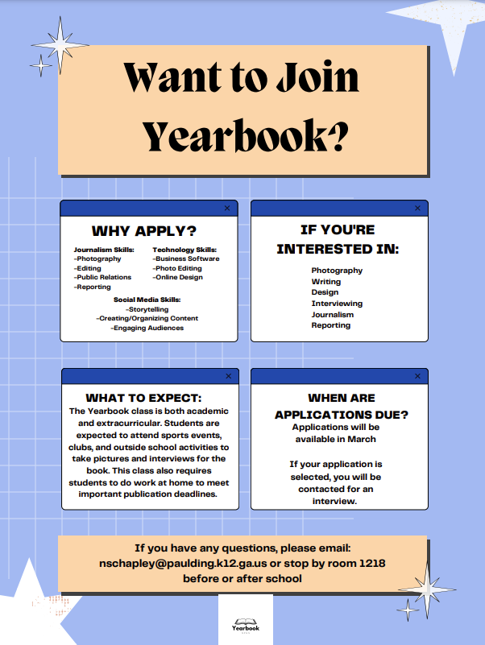
Electives with Applications: Journalism

Slide 28
Yearlong Electives
If you sign up for the following electives, you are making a yearlong commitment.
Band
Chorus
JROTC
Journalism

Slide 29
Required Electives
Health and Personal Fitness are not electives. Every student must take Health and Personal Fitness to meet graduation requirements.
The only exception to this rule is for JROTC students. You must successfully complete 3 semesters, earning 3 credits, in JROTC to exempt the Health and Personal Fitness Requirement.
If you have not had Health, Personal Fitness or JROTC, please contact your counselor.
World Language – You do not have to take a world language to graduate. However, you do need 2 years in the same language to enter most four-year colleges.
Example: Spanish 1 & 2 or French 1 & 2. Not Spanish I and French I.

Slide 30
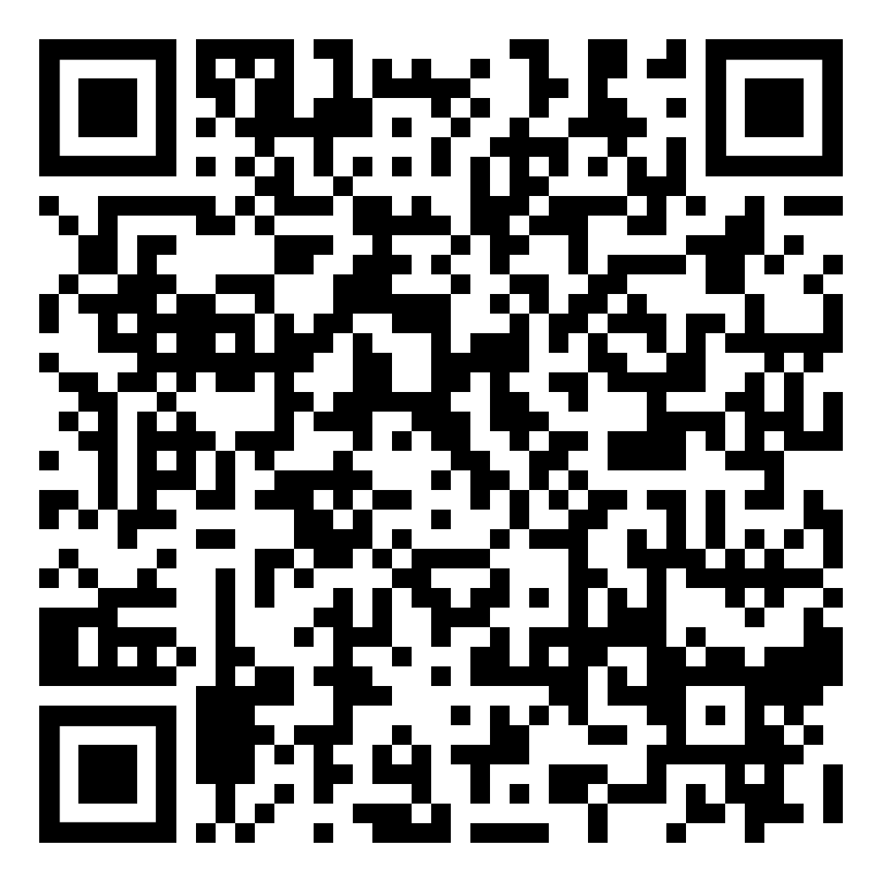
Elective Registration Link
If you’ve NOT submitted your elective registration form, you must do so at this time. Scan the QR code OR find the Registration page from our counseling website at www.gonphs.weebly.com
Complete only one entry. If you need to make a change to your elective requests, you need to email your assigned counselor. Entering more than one entry, may cause confusion for your schedule next school year.
Students will choose EIGHT (8) elective courses/pathways. Rank the courses in order (first choice is selection 1, second choice is selection 2, etc.).
Students may be scheduled for any of the 8 electives they chose. Choose wisely. No elective changes may be made when school begins.
Don’t forget your World Language if you plan to attend a 4-year college. This should be your first elective choice.

Slide 31
Counseling Resources
Did you know that school counselors hold at least a master’s degree and are trained in mental health? We are here to support students through social, emotional, and academic needs.
Crisis Numbers – Free, Confidential, 24-hours/Day, 7 Days/Week
Text the number 988 or see their website at 988lifeline.org for resources
OR
Text the “Hello” to 741741
Additional mental health resources are available on our counseling website, under the “more counseling resources” tab.

Slide 32
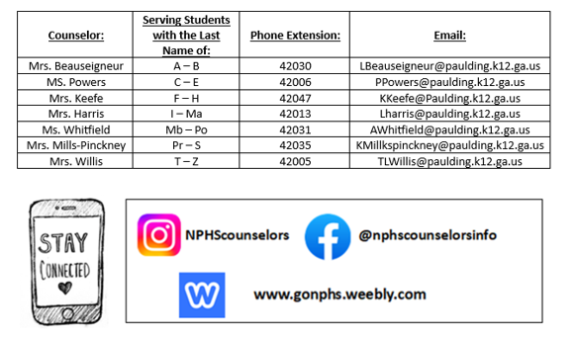
Counselor Contact

Slide 33
Send a text to 81010 or use the Remind App
@NPHS-2025

Slide 34
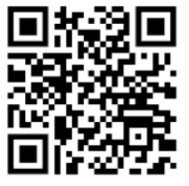
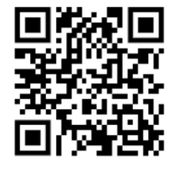
What to work on…
Completing the elective form if you’ve not done so (link sent via Canvas) or can be found on our counseling website www.gonphs.weebly.com
2. Completing your Bridge Bill Activities. Found in your grade level Canvas Advisement Page
3. Completing the Ga Health Survey and Drug Free Paulding Survey (see QR code’s below)
4. Creating your GAFutures account or reviewing your account if you’ve already created one. Review your HOPE GPA and Rigor courses.
(Gafutures.org)
Ga Student Health Survey
Drug Free Paulding Survey

