Slide 1
BRIDGE BILL JUNIORS
SELECT THREE COLLEGES

Slide 2
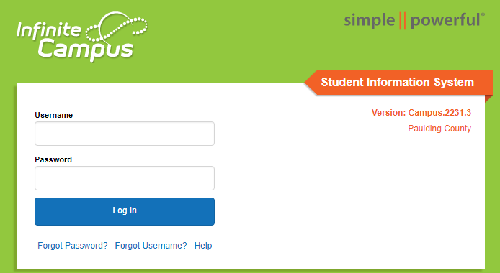
STEP 1
Using Google Chrome -- Login to Your Infinite Campus Account at
Campus.Paulding.k12.ga.us

Slide 3
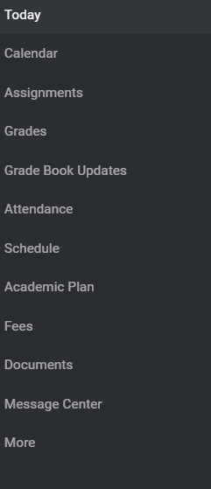
STEP 2
On your Infinite Campus Portal Page
Click on MORE (Left-Hand Side)

Slide 4
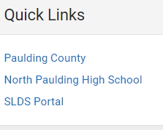
STEP 3
Click on the blue SLDS Portal Tab (Right side of the page)

Slide 5
STEP 4
Click on My Career Plan Box

Slide 6
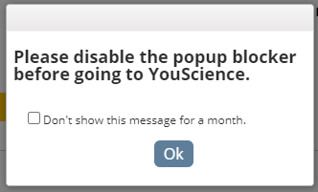
STEP 5 & 6
Click on the Go To YouScience Tab
Click on the OK Button for the Pop-Up Blocker

Slide 7
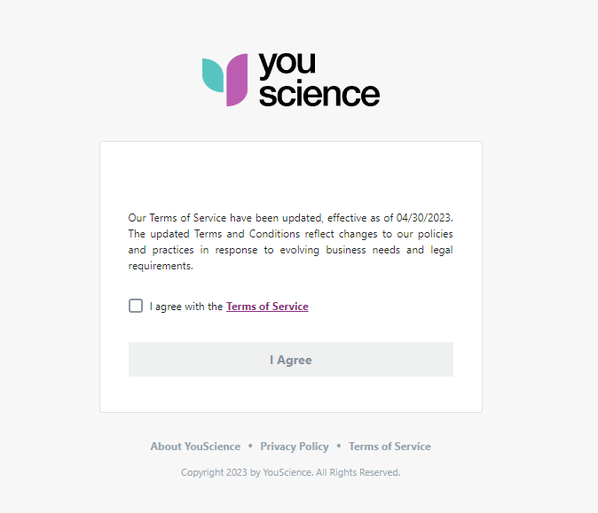
STEP 7
Select the box “I agree with the terms and service” and select “I agree”

Slide 8
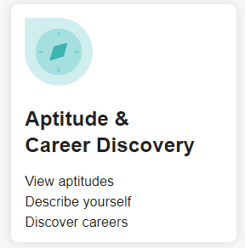
STEP 8
Choose the box “Aptitude & Career Discovery” from the next page.

Slide 9
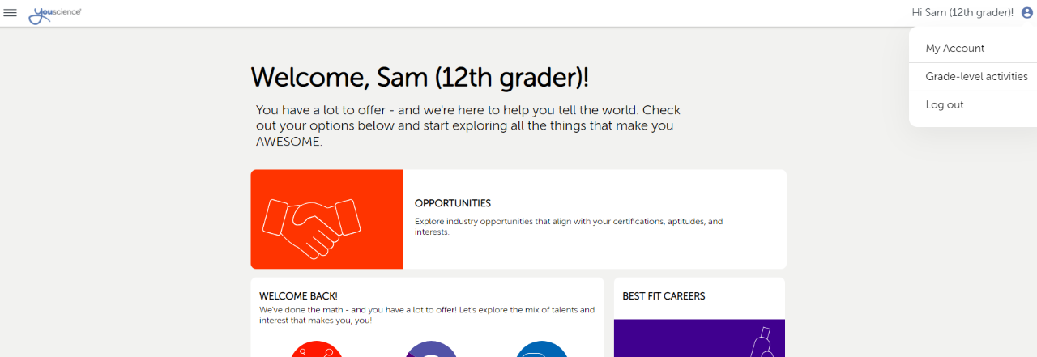
STEP 9
Make the Next Page – Full Screen
Go To the Top Right Corner
Click on the Blue Circle
Then Click on Grade-Level Activities

Slide 10
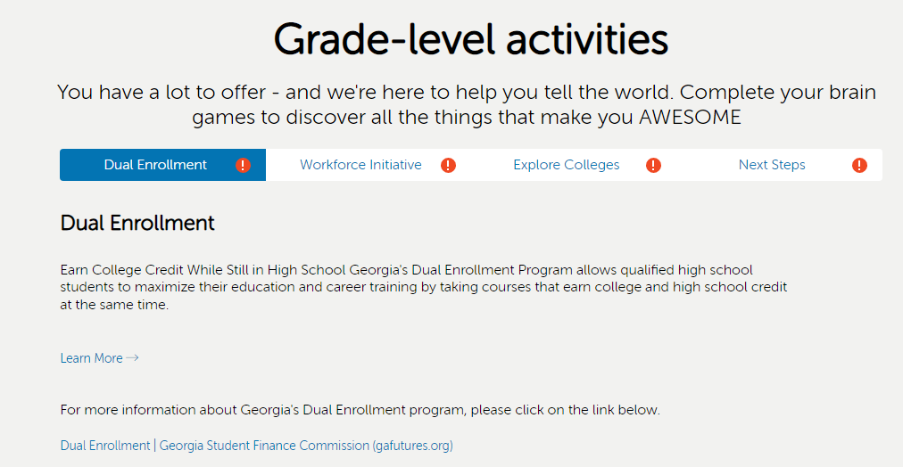
STEP 10
Highlight Dual Enrollment Tab
Click on Learn More
Review the Dual Enrollment Page for Information

Slide 11
STEP 11
When you have finished reviewing the dual enrollment information –
Close out of the dual enrollment informational tab
This will take you back to the My Career Plan
Click on the Go To YouScience Tab and then OK

Slide 12
STEP 12
Choose the box “Aptitude & Career Discovery” from the next page.

Slide 13
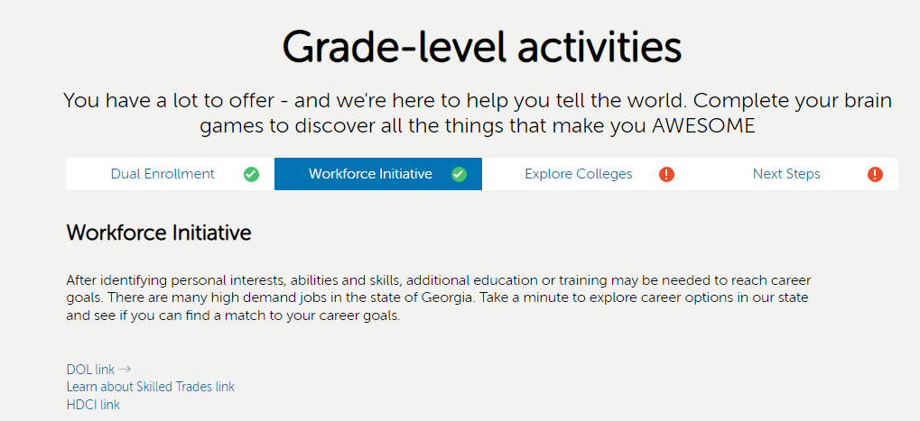
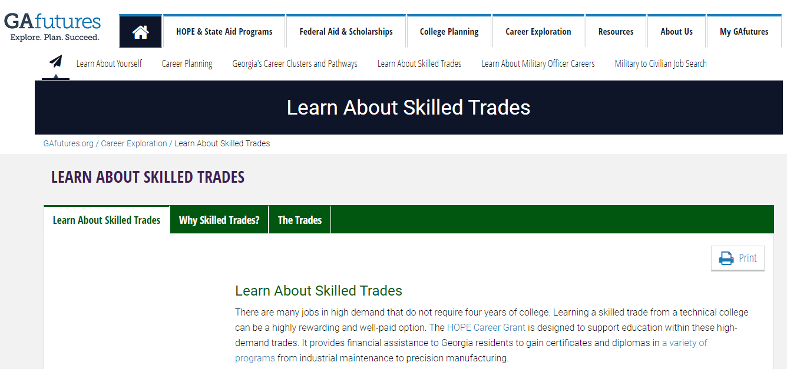
STEP 13
Highlight the Workforce Initiative Tab
Click on the DOL Link, to learn more about the Dept. of Labor (Go back to Home Page)
Click on the Learn about Skilled Trades Link (Go back to Home Page)
Click on the HDCI Link to Learn more about High Demand Career Initiative (Go back to Home Page)

Slide 14
STEP 14
When you have finished reviewing the dual enrollment information –
Close out the workforce initiative tab
This will take you back to the My Career Plan
Click on the Go To YouScience Tab and then OK

Slide 15
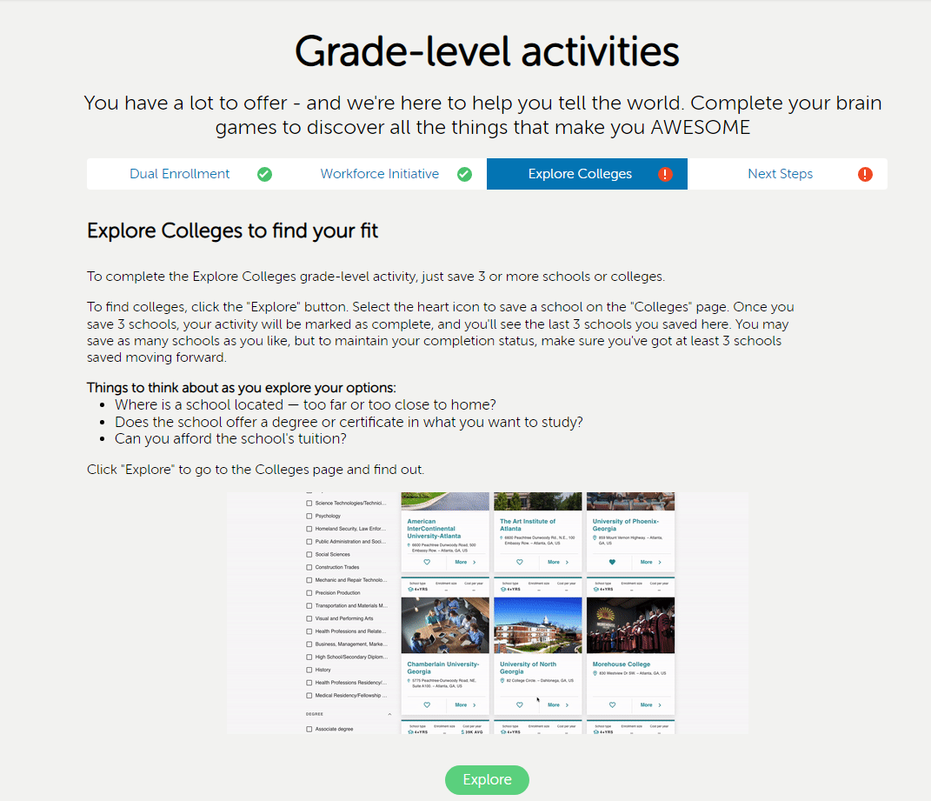
STEP 15
Highlight the Explore Colleges Tab
Read Instructions – Then Click the Green Explore Tab

Slide 16
STEP 16
Choose the “start exploring” if you are unsure what college you want to attend OR choose the “find my college” if you have a college in mind you want to attend.

Slide 17
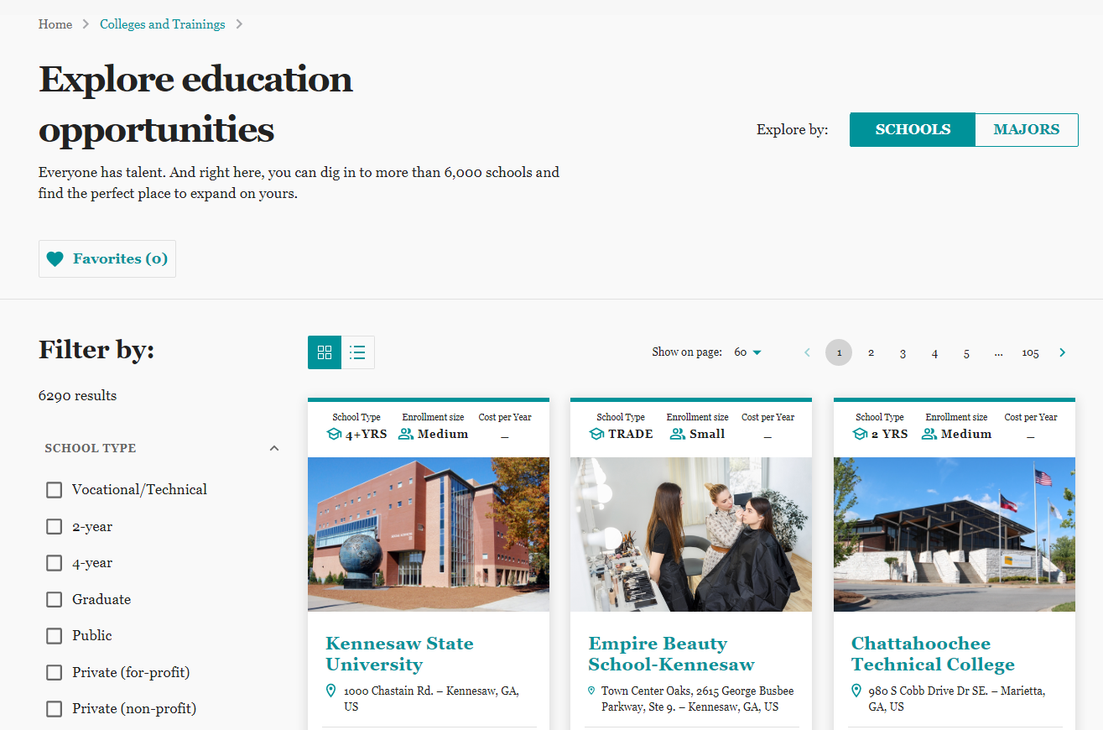
STEP 17
Explore Education Opportunities
There is a Filter by Feature to Use
Click on the Heart Button if you are interested in that School
You will need to choose 3 different schools
Notes:
.

Slide 18
STEP 18
Explore Education Opportunities
There is a Filter by Feature to Use
Click on the Heart Button if you are interested in that School
You will need to choose 3 different schools
You Have Completed this Activity when the Favorites Tab show (3)

Slide 19
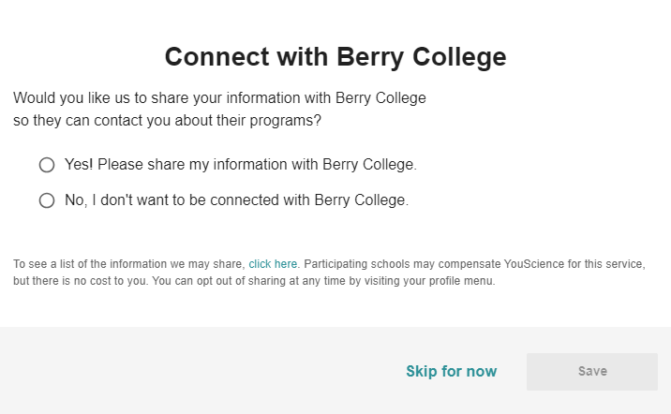
STEP 19
Once you save a college, these steps are optional. If you do not want to answer these questions, please select “skip for now.”

Slide 20
STEP 20
Once you have saved 3 colleges go back to the You Science home page
You will have completed the Junior Bridge Bill State Requirements when the following Grade-Level Activities show Green
Dual Enrollment
Workforce Initiative
Explore Colleges

