Slide 1
BRIDGE BILL FRESHMAN
DUAL ENROLLMENT
SELECT THREE CAREERS

Slide 2
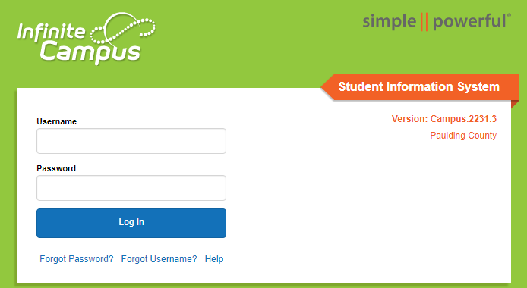
STEP 1
Using Google Chrome -- Login to Your Infinite Campus Account at
Campus.Paulding.k12.ga.us

Slide 3
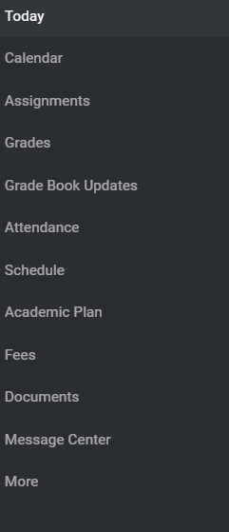
STEP 2
On your Infinite Campus Portal Page
Click on MORE (Left-Hand Side)

Slide 4
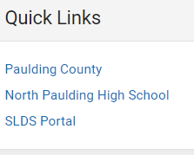
STEP 3
Click on the blue SLDS Portal Tab (Right side of the page)

Slide 5
STEP 4
Click on My Career Plan Box

Slide 6
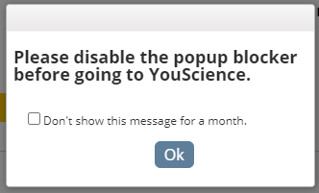
STEP 5 & 6
Click on the Go To YouScience Tab
Click on the OK Button for the Pop Up Blocker

Slide 7
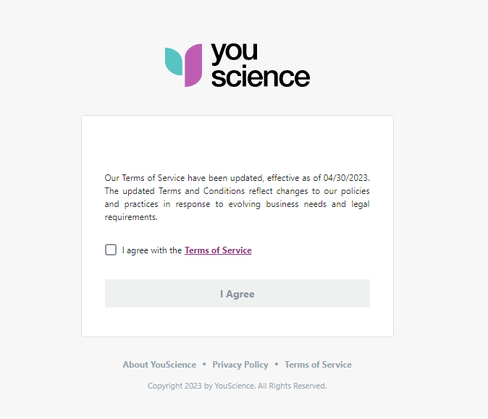
STEP 7
Select the box “I agree with the terms and service” and select “I agree”

Slide 8
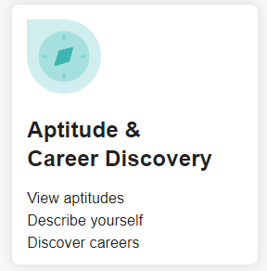
STEP 8
Choose the box “Aptitude & Career Discovery” from the next page.

Slide 9
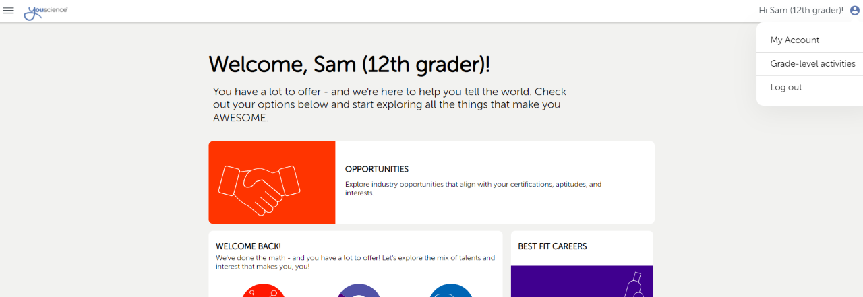
STEP 9
Make the Next Page – Full Screen
Go To the Top Right Corner
Click on the Blue Circle
Then Click on Grade-Level Activities

Slide 10
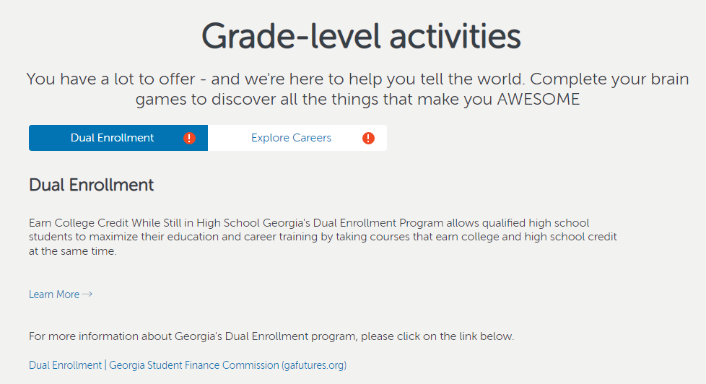
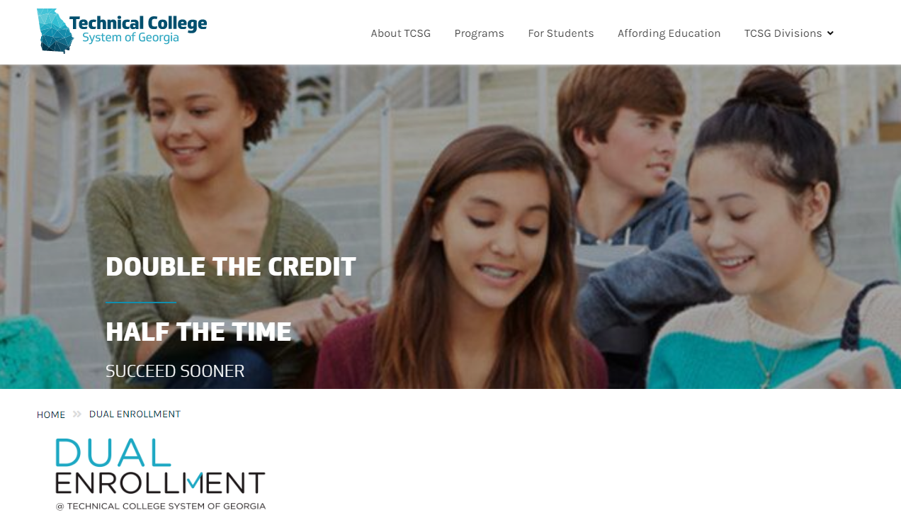
STEP 10
Highlight Dual Enrollment Tab
Click on Learn More
Review the Dual Enrollment Page for Information

Slide 11
STEP 11
When you have finished reviewing the dual enrollment information –
Close out the dual enrollment informational tab
This will take you back to the My Career Plan
Click on the Go To YouScience Tab and then OK

Slide 12
STEP 12
Choose the box “Aptitude & Career Discovery” from the next page.

Slide 13
STEP 13
This brings you back to the beginning
Make the Page – Full Screen
Go To the Top Right Corner
Click on the Blue Circle
Then Click on Grade-Level Activities

Slide 14
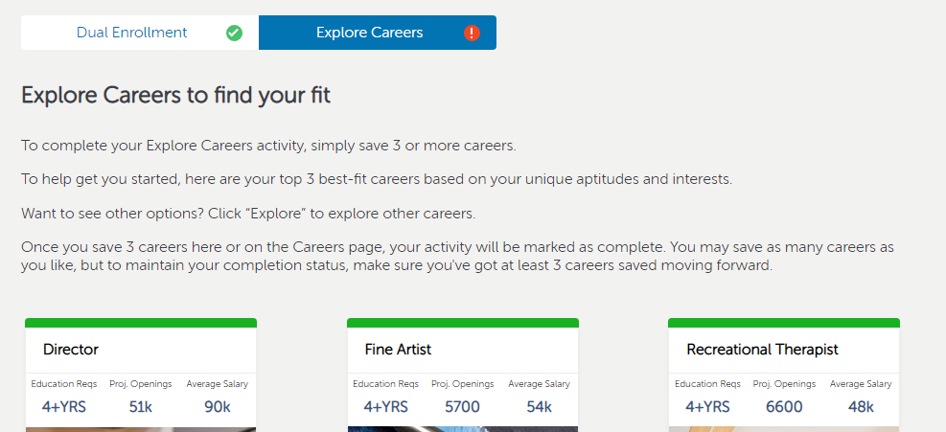
STEP 14
You should see the Dual Enrollment Tab has a green checkmark
Highlight the Explore Careers Tab
Read Instructions – Then Click the Green Explore Tab

Slide 15
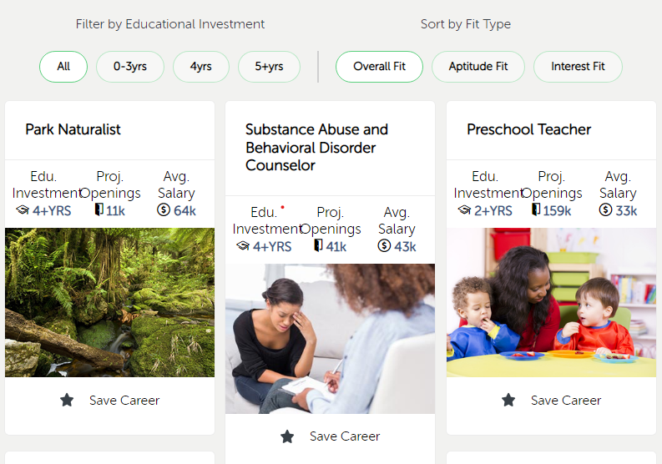
STEP 15
Explore All Careers or Filter by Years Spent in College or Your Fit Type
Click on the Star Button if you are interested in that Career
You will need to choose and save 3 different careers
You Have Completed this Activity when the Saved Careers Tab shows 3 more Saved Careers (Some of you may have saved careers from 8th grade)
*This is an example of saved careers from Middle School – *You must save 3 more to complete the activity – making it a total of 5 careers for this student
*Some of you may have 3 saved careers from Middle School – making it a total of 6 saved careers to complete the activity.

Slide 16
STEP 16
Go Back to You Science Home
You will have completed the Freshman Bridge Bill State Requirements when the following Grade-Level Activities have a Green Checkmark
Dual Enrollment
Explore Careers

