Slide 1
Accessing YouScience

Slide 2
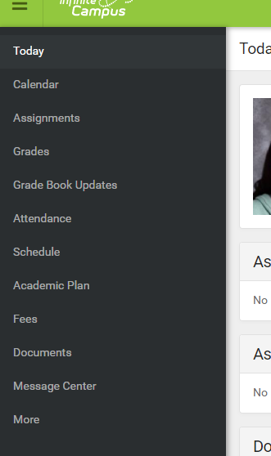
1. Log into your student portal - IC
On the left-hand side of the screen, click on the ‘more’ option

Slide 3
2. Scroll down
At the bottom of the page, find the link for ‘SLDS Portal’

Slide 4
3. A New screen will open
Click on ‘my career plan’

Slide 5
4. The page will look like this…
You’ll see your name and grade level where the face is on the slide.
Click on the button that says ‘go to YouScience’

Slide 6
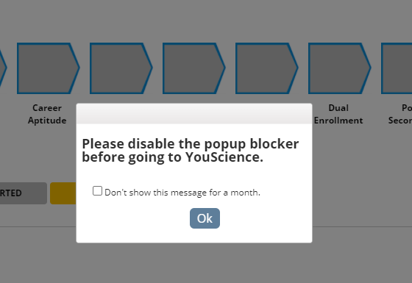
You might get this popup… click “ok”
If you know how, check to see that your popup blocker is disabled.

Slide 7
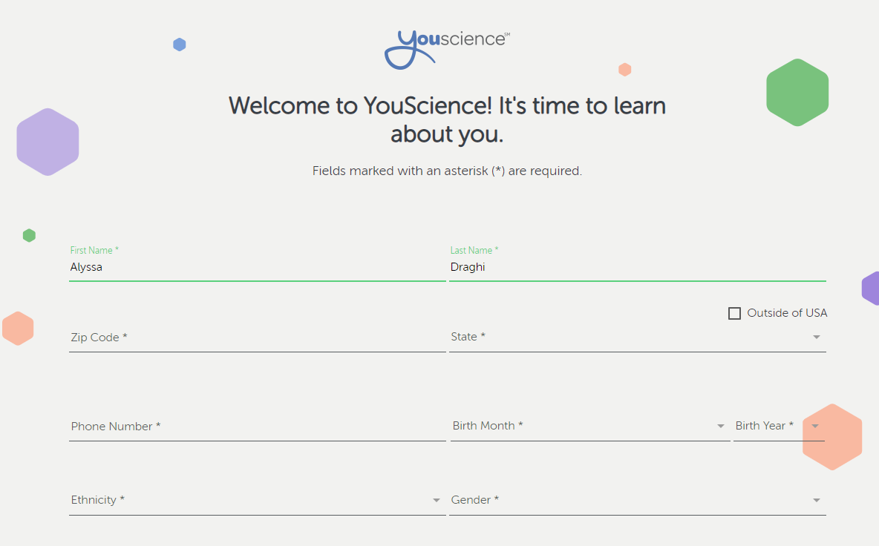
Then you will create a YS profile
Use your personal email address. You will have access to your account for 10 years.

Slide 8
remember
There are 11 brain games/activities
Each activity takes 5-10 minutes
Read the directions before each activity
Do not stop in the middle of an activity – some of them are timed
Try your best, and remember not all the activities are supposed to be easy for you
When you finish an activity, your progress will automatically save
Make the most out of this, and try not to let your surroundings distract you
after you finish all activities, you will get an email when your results are ready

