Slide 1

Summit
Student Results Walk-through

Slide 2
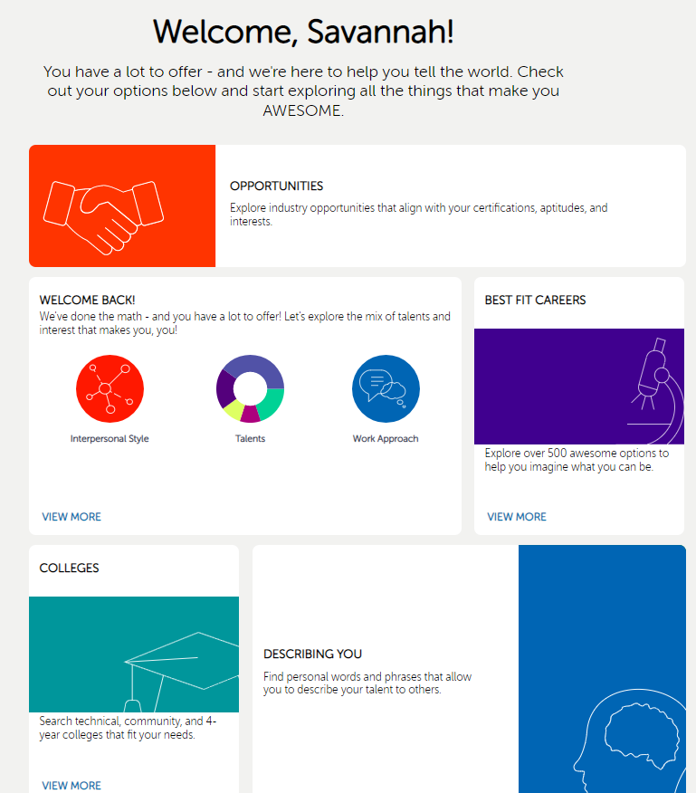
The student portal has positive affirmative language. It’s always important to let students know they are not being grader or compared to their peers.
It includes five different sections. Each section has its own function. Let’s review…
Notes:
Results walk-through videos - https://knowledgebase.precisionexams.com/results-walk-through-videos?__hstc=63881840.6de9b92e2928a31ac2758682fdf5ba6a.1649088813309.1675445933818.1675451309724.628&__hssc=63881840.1.1675451309724&__hsfp=49869365
In-depth results walk-through guide - https://knowledgebase.youscience.com/in-depth-results-walk-through-guide?__hstc=63881840.6de9b92e2928a31ac2758682fdf5ba6a.1649088813309.1675445933818.1675451309724.628&__hssc=63881840.1.1675451309724&__hsfp=49869365

Slide 3
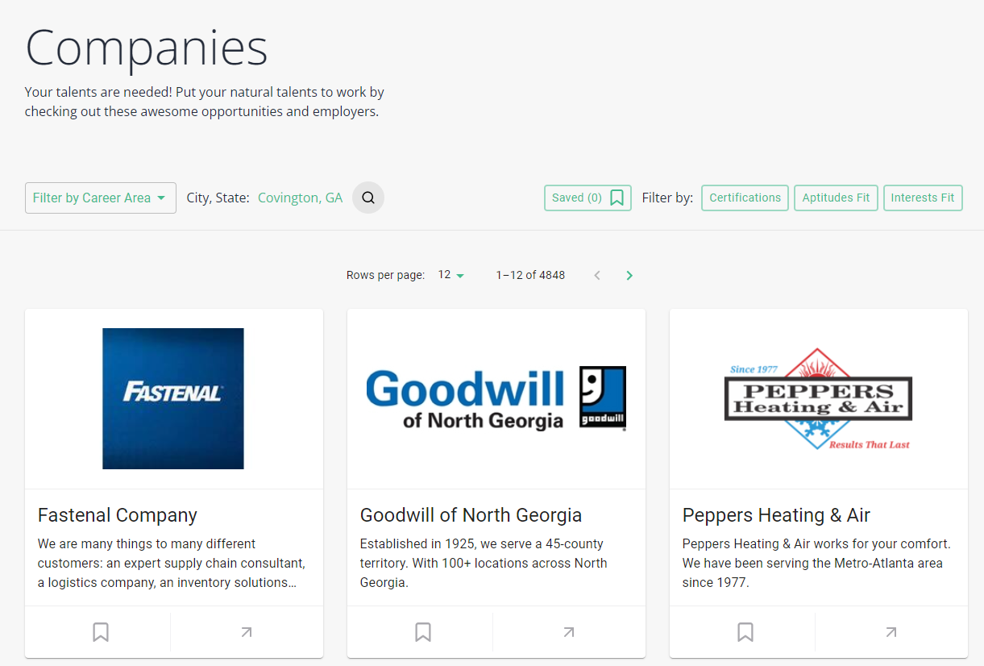
Opportunities - for students to explore
Local employers can create their profiles by entering their company information and indicating the skills desired from potential employees. Using a proprietary algorithm that matches individuals’ talents and skills, YouScience identifies individuals that are well-suited to meet employers’ human resource needs.
Qualified candidates are aligned to suitable employment opportunities through YouScience Employer Connections. This allows your company to get in front of talent earlier and opens the door for future internships, work-based learning opportunities, or even full-time work.

Slide 4
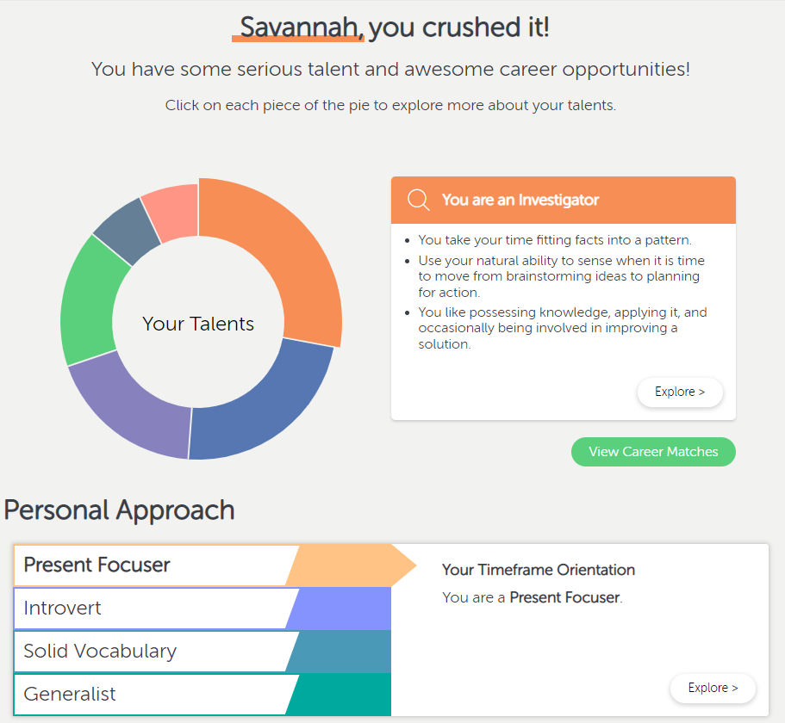
Welcome Back! (Aptitudes)
The talent wheel will show the student their aptitudes and the box next to it will give a short summary of the talent.
Students can then click on “explore” and take a deep dive into their aptitudes.

Slide 5
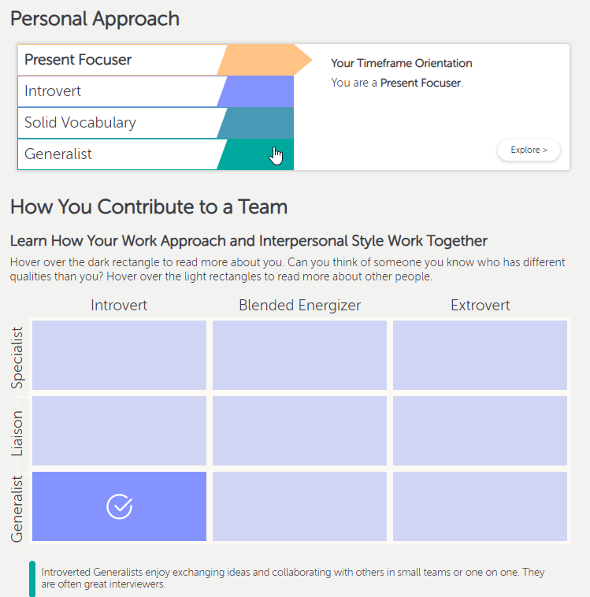
continuation…
Next is the students personal approach and how they contribute to a team.

Slide 6
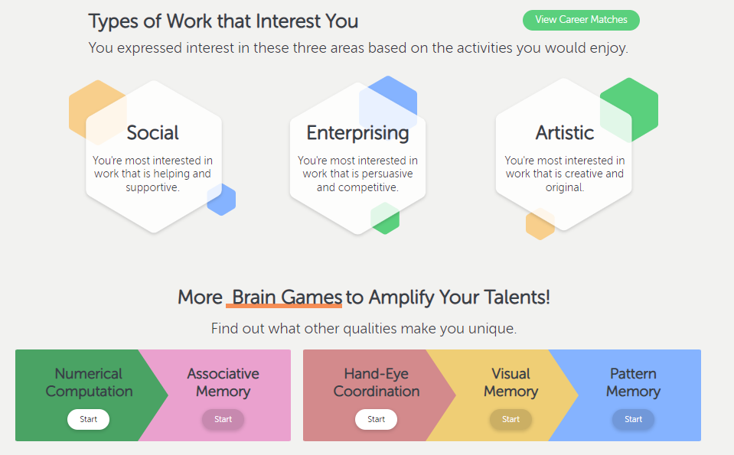
continuation…
Students interests and amplifier brain games (not mandatory.

Slide 7
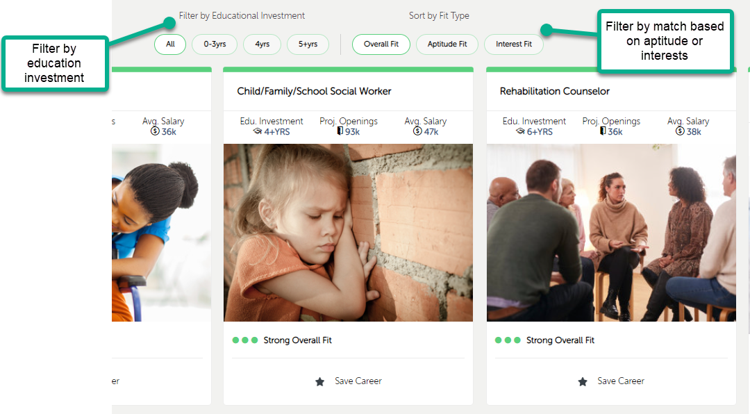
Best Fit Careers

Slide 8
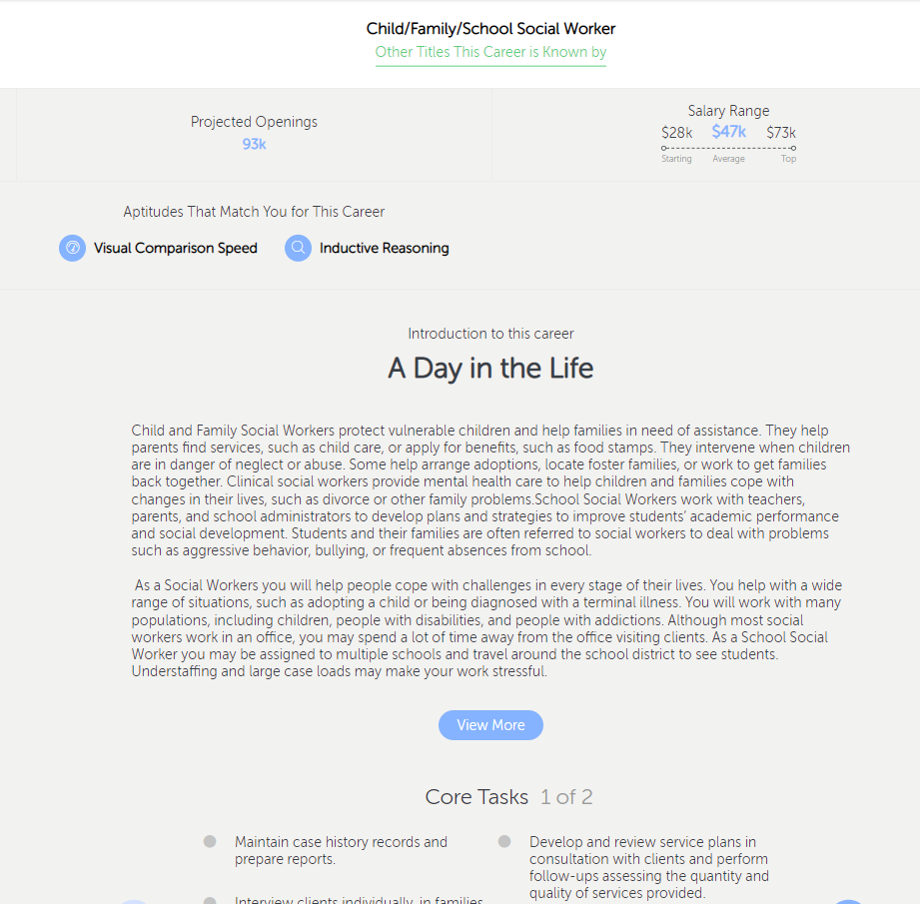
Explore a day in the life of someone in this career. The core tasks, how you are matched to this career, educational summary and industries. Along with expected job openings and salaries.

Slide 9
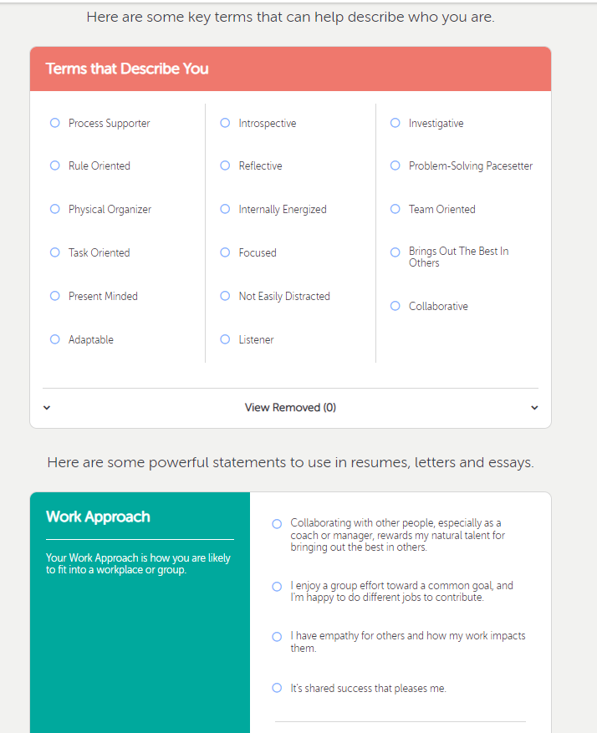
Describing You
This section can be used to create resumes, letters of recommendation, essays and mock interviews.
You will find single words to help describe yourself and full sentences grouped by each of your aptitudes.

Slide 10
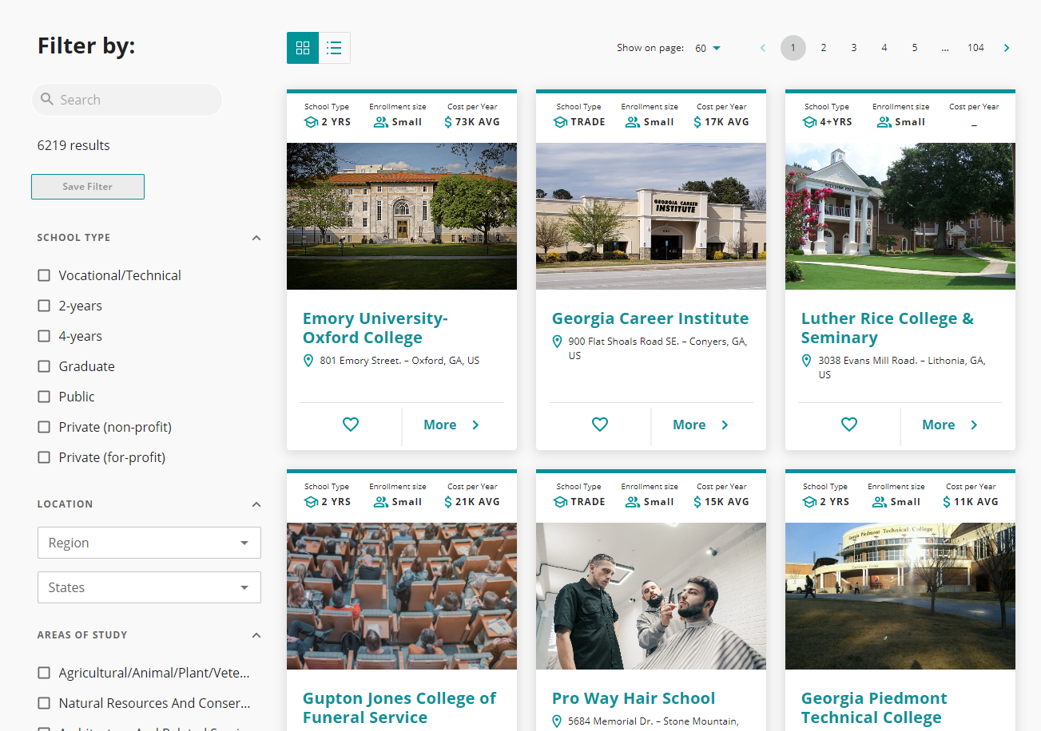
Colleges
Students can explore colleges and filter by school type, location and areas of study offered.
Click on the specific school to see details about it.

Slide 11
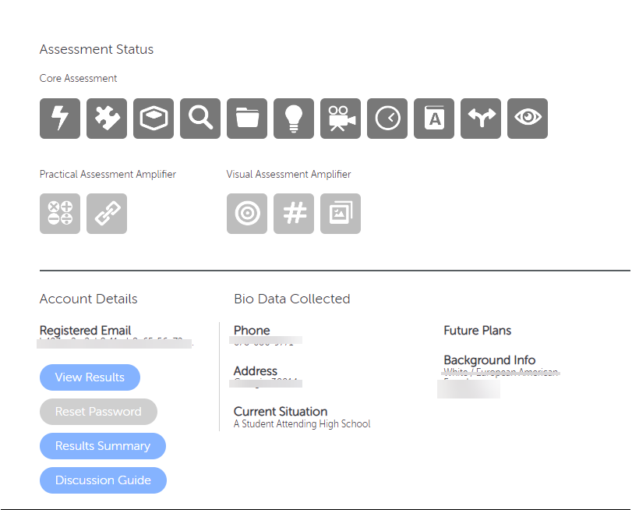
As an admin, you can impersonate a student by clicking on “view results.”
You can also print or save the student’s “Result Summary” this is a personalized summary of the students results that can be shared with parents.
The “Discussion Guide” is also a great summary of the students results in a conversational way.
Notes:
How to view student results - https://knowledgebase.youscience.com/discovery-view-student-results

Slide 12
Lesson Plans
Pre and Post Describing You Exercise (HS)
Diving Deeper - Researching a Career (HS)
Post-it Activity- Building Self-Efficacy and Self Worth (HS)
Conducting Mock Interviews (HS)
Informational Interviews (HS)
College Search and Exploration (HS)
Resume Language (HS)
Post-Secondary Next Steps (HS)
Cover Letter Exercise (HS)
YouScience Highlight Board (HS)
Six Degrees of Separation (HS)
Flipgrid Elevator Pitch — 9th-12th Grade Classroom Activity
Draft Your Dream Team — 9th-12th Grade Classroom Activity

