Slide 1
Sophomore Class of 2026 Counselor Meeting

Slide 2
Graduation Requirements
Understanding Academic Recommendations for next school year
Special Programs
Work-Based Learning
Early Graduation
Elective Registration
Mental Health Resources
Bridge Bill
Health Survey

Slide 3
Graduation Requirements
Students must complete and pass 23 classes to graduate per the Georgia Department of Education. These credits must be earned in specific subject areas.
4 credits in English
4 credits in Math
4 credits in Science
3 credits in Social Studies
1 Personal Fitness and Health or 3 credits in JROTC
3 credits in CTAE/Fine Arts/World Language
4 Electives

Slide 4
Understanding Academic Registration
Each semester, your teachers make course selections for you based on how you performed in their classes that semester.
For fall semester, this was done at the end of the semester. For this semester, teachers have already made these selections.
Many times, teachers will have discussions with the students about their recommended placement.
Please take an active role in your education by asking questions. You and your parents/guardians will be able to view your recommended courses in your Academic Planner on Infinite Campus in April. Your academics should not be a surprise in August when you get your schedule.
In April, you may request changes by communicating with your Counselor.
All changes need to be made by the end of April so we can allot our teachers and classes for next school year.

Slide 5
Academic Registration
Students will typically take the following academic classes for 10th grade year:
English: American Literature or Honors American Literature or AP Language/Comp. Students who are currently taking Honors American Literature may take Honors Multicultural Literature or AP Literature. Students may also take Multicultural Literature (non-honors)
Math: Advanced Algebra C&C or Honors Advanced Algebra C&C. Students who are currently taking Honors Advanced Algebra C&C will take Honors pre-calculus or Pre-Calculus (non-honors)
Science: Students must take Physical Science or Physics to graduate from high school. Junior students will most likely take Physics or Honors Physics, Environmental Science, or Chemistry.
Social Studies: US History, Honors History, or AP US History
As a reminder, if you failed a course required to graduate, you will need to take the failed course in summer school (more information to come) or you will need to take it next school year and double up in that subject area.

Slide 6
Honors/AP
Students who take an Honors course earn 5 additional bonus points on their final grade when passed with a 70 or higher.
Students who take an AP course earn 10 additional bonus points on their final grade when passed with a 70 or higher.
As a reminder – the HOPE program removes bonus points awarded.
If you want to take an Honors or AP course, and your teacher did not recommend you for the course – please see a counselor to complete an Honors/AP waiver.
If your teacher recommends Honors/AP and you do not want to take this level, you need to let your counselor know before the end of April for scheduling reasons.
There is no guarantee you may drop your Honors or AP course if the on-level course is full come August. Please select your academics and electives wisely.

Slide 7
Academic Planner
As mentioned in a previous slide, students will review their courses to ensure the academics and electives that are entered in their academic planner are correct.
Counselors will email parents when all registration has been completed. During this time, students and parents must review this information. Counselors will also send out reminders to students through Canvas to check their academic planner. Be sure you are reviewing these messages.
Students will not be able to make a change to the academic planner through Infinite Campus. You will need to email your assigned high school counselor and request a change be made.
Again, all changes must be completed come end of April 2023.
Helpful Hint: Add a reminder to your calendar and set a notification to check your academic planner by April 10th.

Slide 8
Athletics
Students are offered the opportunity to play a sport in high school. Each high school has various sports students may try out for. Be sure to contact the head coach of each sport and ask about conditioning and tryout information.
Some teams begin conditioning in the summer.
Students will need a physical on file with North Paulding High School to participate in workouts, conditioning, and tryouts.
Did you know…
To play sports in high school students must earn 2.5 credits each semester to be eligible to play. This is a Georgia High School Association (GHSA) guideline that is followed by all Georgia high schools.
Also, students must be on-track to graduate and in their cohort grade level

Slide 9
GA Futures
Gafutures is the website you will use to monitor your Hope GPA. At the end of each semester, when final grades are posted to your transcript, students will be able to log into their GA Futures account and view their HOPE GPA.
Students will create this account on their own. They will need to enter their legal information including their social security number to display the HOPE GPA.
Ga Futures is your go to website to learn all about the HOPE scholarship, look for scholarships, apply to colleges, and so much more!
www.Gafutures.org

Slide 10
HOPE Scholarship
The HOPE Scholarship is an opportunity for students to earn tuition toward college courses after they graduate from high school.
The HOPE scholarship can be applied to four-year and two-year colleges, as well as private colleges. Students must attend a Georgia college for funding availability.
The HOPE GPA (grade point average) and your high school GPA are NOT the same!
The Hope Scholarship only calculates your GPA for core courses and world language (English, Math, Science, Social Studies, and World Language).
By law, the HOPE GPA does not round
If a student takes an honors course, the 5 additional bonus points are removed for the students HOPE GPA calculation.
If a student takes an AP course, the 10 additional bonus points are removed for the students HOPE GPA calculation. However, the Hope program does award .5 points back to the HOPE GPA calculation.
High School courses taken in middle school are not calculated in a students' HOPE GPA.
Students will be able to view their HOPE GPA through their GA Futures account. This is created during 9th grade year on your own. Visit the GA Futures website to create an account.

Slide 11
HOPE Scholarship Cont.
Qualifications for HOPE (covers a portion of your public or private college tuition):
3.0 HOPE GPA
4 Rigor Courses
No SAT or ACT requirement to receive HOPE
Qualifications for Zell Miller Scholarship (covers 100% college tuition for a public college, and a portion for private college)
3.7 HOPE GPA
4 Rigor Courses
SAT Score -1200 (composite)
ACT Score – 25 (composite)
Please visit the GA Futures website to learn more about the Hope Scholarship
WWW.GAFUTURES.ORG

Slide 12
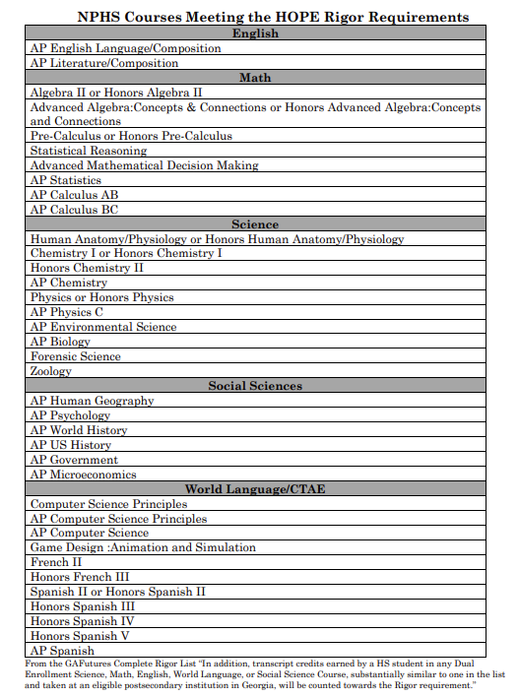
The courses listed on this slide are current NPHS classes that are considered rigor with GA Futures.
To view the full list of all rigor courses students should visit the GaFutures website:
https://www.gafutures.org/media/4wsjm2ej/rigor-list-september-2023-print-ready-10032023.pdf

Slide 13
End-of-Course Assessment (EOC)
EOC’s are end of course assessments that will count for 20% of a student's final grade. These are state mandated tests.
Courses with EOC’s are Algebra I, Biology, American Literature, and US History.
EOC’s cannot be exempted, unlike teacher finals.

Slide 14
Special Programs
Available through Paulding County School District and North Paulding High School
Notes:
Now that you know what is required of you for core academics, we are going to review the programs that are available to you. Most of these programs are outside of NPHS but still affiliated with it. All programs discussed have grades that will be reflected on your NPHS transcript.

Slide 15
Paulding College and Career Academy (PCCA)
Pathways Offered
Healthcare
Dual Enrollment Opportunities
Certified Nursing Assistant Opportunity & Certified Medical Assistant
Patient Care Technician Opportunity
Mechatronics/Manufacturing
Electronics, Computers/drafting, Robotics
Dual Enrollment Opportunities
Energy
Lineman/Technician
Cybersecurity
Dual Enrollment Opportunities
IT
DELL Certificate
Serves all 5 high schools Paulding County.
Programs are housed at New Hope Education Center
Transportation is provided to and from NPHS for classes.
Offers courses and pathways specifically selected based upon the work needs of the surrounding area and the state.
Let your counselor know via email if you are interested in attending PCCA for Fall 2024, before the last day of school.
Notes:
The Paulding College and Career Academy, also known as PCCA, is a program that serves all five high schools in Paulding County. That means that students from all over the county are bused in to participate in these programs. PCCA is housed at New Hope Education Center. Do not let the fact that it is off campus deter you from signing up for PCCA as transportation is provided for all student to and from NPHS. PCCA offers courses and pathways specifically selected based upon the work needs of the surrounding area and the state as a whole.
The pathways offered at PCCA include Healthcare, Mechatronics, Energy, and Cybersecurity. There are dual enrollment opportunities associated with most of these, along with certifications that provide career opportunities after graduation.
Please see the PCCA promotional video for more information.

Slide 16
Online Opportunities
Online at NPHS
Online at Home with Paulding Virtual Academy
Is there a course not offered at NPHS that you would like to take?
Did you fail a class and want to recover it online instead of in a class?
Would you prefer to take an online class during the school day in a lab setting?
These opportunities are available for you. Talk to your counselor about how to do this.
For a fully online experience while remaining a North Paulding student, applications for Paulding Virtual Academy will soon be provided to parents and students.
Please note that this is a yearlong commitment.
Students who want to take a new credit course online should complete the SB 289 application available in April on the PCSD website.

Slide 17
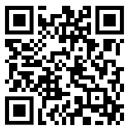
Work-Based Learning (Juniors and Seniors only)
Program available for students who have a job and would like to earn credit for working while also haven an abbreviated high school schedule.
Students who work 7.5 hours a week qualify for 1 block of WBL. Students who work 15+ hours a week qualify for 2 periods of WBL.
Students MUST have a job by the start of the school year, and must have transportation, be on track for graduation, and have a good attendance record.
Junior students are not guaranteed a parking pass. Students may apply for the WBL program and will be approved based on parking availability.
Students interested in the Work-Based-Learning (WBL) program, will need to complete the application (scan QR code).
Due April 1, 2024

Slide 18
Dual Enrollment (Juniors & Seniors Only)
What is it?
What are the Benefits?
Students can take courses from a state public or private college while still enrolled as a high school student and receive credit both at the high school and at the postsecondary institution.
Most college classes (up to 10) are free for high school students.
Expand course offerings
Save money on college.
Get ahead on college coursework.
Flexible schedule.
Quicker entry into the workforce.
Considerations
Deadlines for Fall of 2024 are usually early spring, so if you are interested, please review all requirements at www.gonphs.weebly.com, click on the Dual Enrollment Tab to read, and contact your counselor.
Maturity Level
Do you meet admission requirements?
Transportation (Dual Enrollment does not guarantee a parking pass.)
Notes:
Dual enrollment is an academic program provided to Juniors and Seniors only. Students can take college classes while still enrolled as a high school student and receive credit at both the college and high school. Most students can take up to 10 free college classes in this program. Some benefits include expanding your course options, saving money on college, getting ahead on college coursework, having a flexible schedule and entering the workforce quicker. Some things to consider would be your maturity level. At college, you’ll be in classes with students older than you and there is no communication between instructors and parents. You have to be an independent learner and be able to advocate for yourself. Also, you must meet college admission requirements such as GPA requirements and SAT or ACT scores.
Deadlines for the Fall of 2022 are usually in early spring, so if you are interested, be sure to review the dual enrollment procedure and contact your counselor.

Slide 19
Early Graduation (Juniors and Seniors only)
Students have an option to graduate early from one of the following options:
Spring semester Junior Year
Fall Semester Senior Year
Students may still participate in prom and senior activities.
If you are considering applying for early graduation, talk with your parent/guardian and school counselor to review options.
Students must turn in a letter of intent to their school counselor by the last day of school (May 22, 2024)
Students can find the early graduation letter of intent and more about the early graduation program by visiting our counseling website and selecting “early graduation” or selecting this link: https://gonphs.weebly.com/early-graduation.html

Slide 20
Elective Registration
Notes:
Online opportunities are available at NPHS as well as outside of NPHS. If you desire to attend school but want to take a course that is not offered, such as Japanese or Gothic Literature, you can! If you failed a course that needs to be recovered and desire to take it online instead of in a class, you can do that, too! Online classes are available for students to take during the school day in a lab setting. There is a Senate Bill 289 application required for some online classes. This will be available on the PCSD website April through June. If you are interested in this option or have questions, please talk to your counselor.
If you prefer to do classes fully online, outside of NPHS, you can do so with Paulding Virtual Academy. The application for this will be available on the Paulding County School District website in April. Please note that if you choose this option, it is a yearlong commitment.

Slide 21
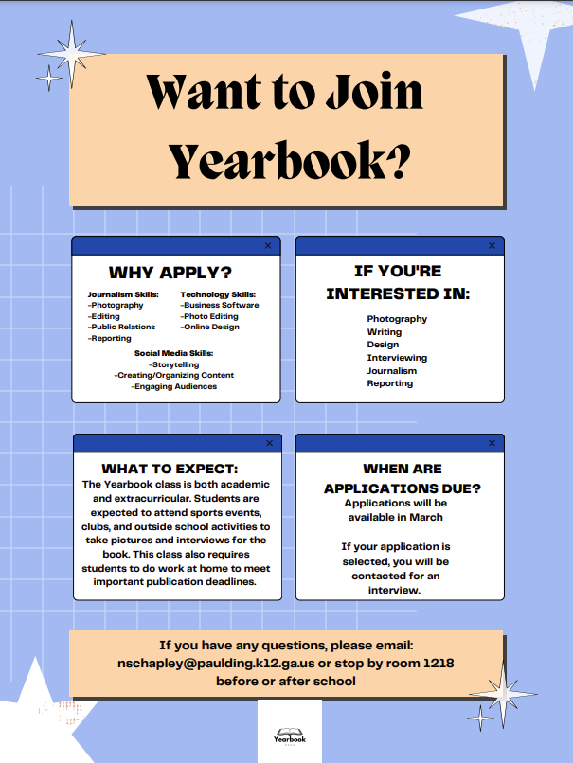
Electives with Applications: Journalism
Notes:
Journalism is an elective course that requires an application. This application will be available later in the semester. Listen for future announcements if you are interested in being on the yearbook staff.

Slide 22
Yearlong Electives
If you sign up for the following electives, you are making a yearlong commitment.
Band
Chorus
JROTC
Journalism
Notes:
Here at NPHS, we offer yearlong electives. If you sign up for the following electives, you are making a yearlong commitment. Those courses are Band, Chorus, and JROTC.

Slide 23
Required Electives
Health and Personal Fitness are not electives. Every student must take Health and Personal Fitness to meet graduation requirements.
The only exception to this rule is for JROTC students. You must successfully complete 3 semesters, earning 3 credits, in JROTC to exempt the Health and Personal Fitness Requirement.
If you have not had Health, Personal Fitness or JROTC, please contact your counselor.
World Language – You do not have to take a world language to graduate. However, you do need 2 years in the same language to enter most four-year colleges.
Example: Spanish 1 & 2 or French 1 & 2. Not Spanish I and French I.

Slide 24
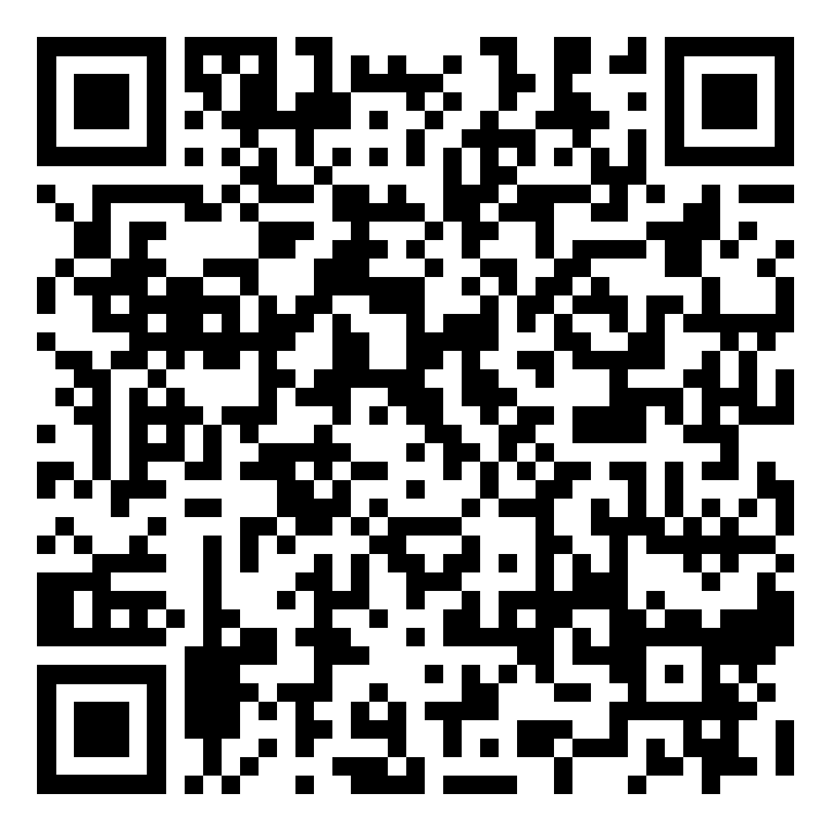
Elective Registration Link
If you’ve NOT submitted your elective registration form, you must do so at this time. Scan the QR code OR find the Registration page from our counseling website at www.gonphs.weebly.com
Complete only one entry. If you need to make a change to your elective requests, you need to email your assigned counselor. Entering more than one entry, may cause confusion for your schedule next school year.
Students will choose EIGHT (8) elective courses/pathways. Rank the courses in order (first choice is selection 1, second choice is selection 2, etc.).
Students may be scheduled for any of the 8 electives they chose. Choose wisely. No elective changes may be made when school begins.
Don’t forget your World Language if you plan to attend a 4-year college. This should be your first elective choice.

Slide 25
Counseling Resources
Did you know that school counselors hold at least a master’s degree and are trained in mental health? We are here to support students through social, emotional, and academic needs.
Crisis Numbers – Free, Confidential, 24-hours/Day, 7 Days/Week
Text the number 988 or see their website at 988lifeline.org for resources
OR
Text the “Hello” to 741741
Additional mental health resources are available on our counseling website, under the “more counseling resources” tab.

Slide 26
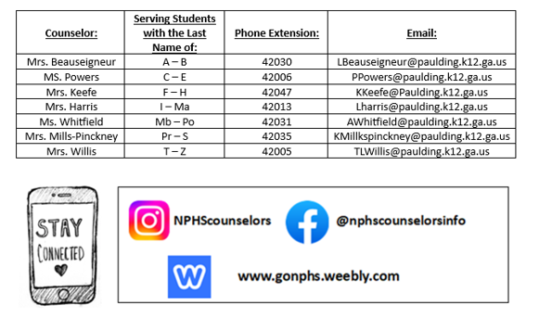
Counselor Contact

Slide 27
Send a text to 81010 or use the Remind App
@NPHS-2026

Slide 28
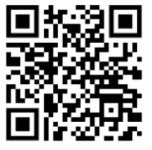
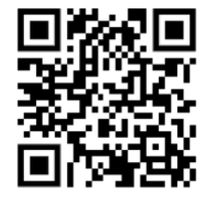
What to work on…
Completing the elective form if you’ve not done so (link sent via Canvas) or can be found on our counseling website www.gonphs.weebly.com
2. Completing your Bridge Bill Activities. Found in your grade level Canvas Advisement Page
3. Completing the Ga Health Survey and Drug Free Paulding Survey (see QR code’s below)
4. Creating your GAFutures account or reviewing your account if you’ve already created one. Review your HOPE GPA and Rigor courses. (wwwGAFutures.org)
Ga Student Health Survey
Drug Free Paulding Survey

