Slide 1
How to View and Understand your Virtual Schedule
(High School Courses)

Slide 2
Step 1: Log-In to Parent Portal
Go to : www.paulding.k12.ga.us and click on “Parent Dashboard”
Click on “Infinite Campus Portal Log-In”:

Slide 3
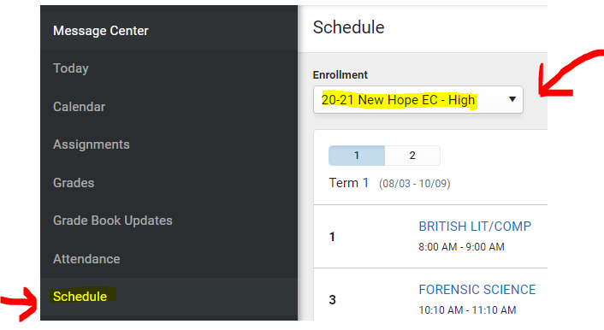
Step 2: Select the correct school
On the Left side of the screen, select “Schedule”
Then, under “Enrollment” select “20-21 New Hope EC- High” (or 20-21 New Hope EC- Middle if you are in 8th grade).

Slide 4
Step 3: Viewing and understanding your schedule
Your schedule will appear, but it will be slightly different than a typical high school schedule.
You may see gaps or multiple courses in one period.
This is ok, as long as you have all of the classes that you need.
If you are mixing Dual Enrollment or in-person high school courses, then you will only see the virtual courses under New Hope. You will need select your home high school to see the others.
Examples of different schedules are on the following slides

Slide 5
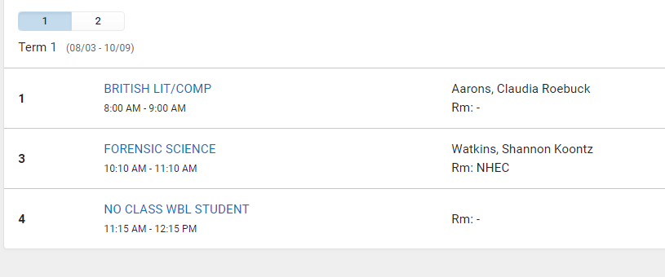
Examples of schedules
From Parent Portal
From a Printed Schedule View

