Slide 1
High School 101
Ms. Andie Whitfield
Notes:
Welcome. You have 20 minutes. Good luck.

Slide 2
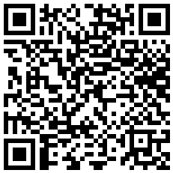
Welcome
Questions during
the presentation:
NPHS School Counselors
Academic Planning
Testing
Athletic Eligibility
Special Programs in PCSD
Common Stressors for Students & How to Address Them

Slide 3
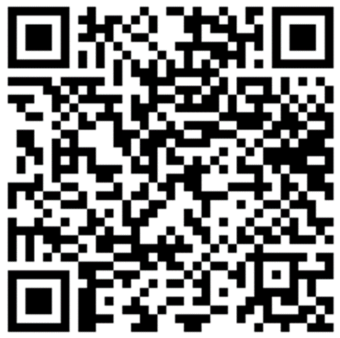
NPHS School Counselors
Mrs. Beauseigneur – Students last names A-B
Ms. Powers – Students last names C-E
Mrs. Keefe – Students last names F-H
Mrs. Harris – Students last names I-Ma
Ms. Whitfield – Students last names Mb-Po
Mrs. Pinckney– Students last names Pr-S
Mrs. Willis – Students last names T-W
Submit questions here:

Slide 4
How can we help?
Social/Emotional
College & Trade School Preparation
Career Planning
Academic Success
Student Advocacy
Connections to Community Resources
And More
We are on the same team!

Slide 5
Advisement Meetings
NPHS Counselors have been meeting with students based on grade level to discuss:
Graduation requirements
Teacher Recommendations
Honors/AP Classes
EOC Testing
Athletic Eligibility
HOPE GPA and the HOPE Scholarship
Elective Registration
Bridge Bill
gonphs.weebly.com

Slide 6
Graduation Requirements
Students must complete and pass 23 classes to graduate per the Georgia Department of Education. These credits must be earned in specific subject areas:
4 credits in English
4 credits in Math
4 credits in Science
3 credits in Social Studies
1 Personal Fitness and Health or 3 credits in JROTC
3 credits in CTAE/Fine Arts/World Language
4 Electives
Grade Promotion:
5 credits to be a Sophomore
11 credits to be a Junior
17 credits to be a Senior

Slide 7
Academic Planning
As mentioned in a previous slide, students will review their courses to ensure the academics and electives that are entered in their academic planner are correct.
Counselors will email parents when all registration has been completed. During this time, students and parents must review this information. Counselors will also send out reminders to students through Canvas to check their academic planner. Be sure you are reviewing these messages.
Students will not be able to make a change to the academic planner through Infinite Campus. You will need to email your assigned high school counselor and request a change be made.
Helpful Hint: Add a reminder to your calendar and set a notification to check your academic planner by April 10th.
Again, all changes must be completed by April 2024.

Slide 8
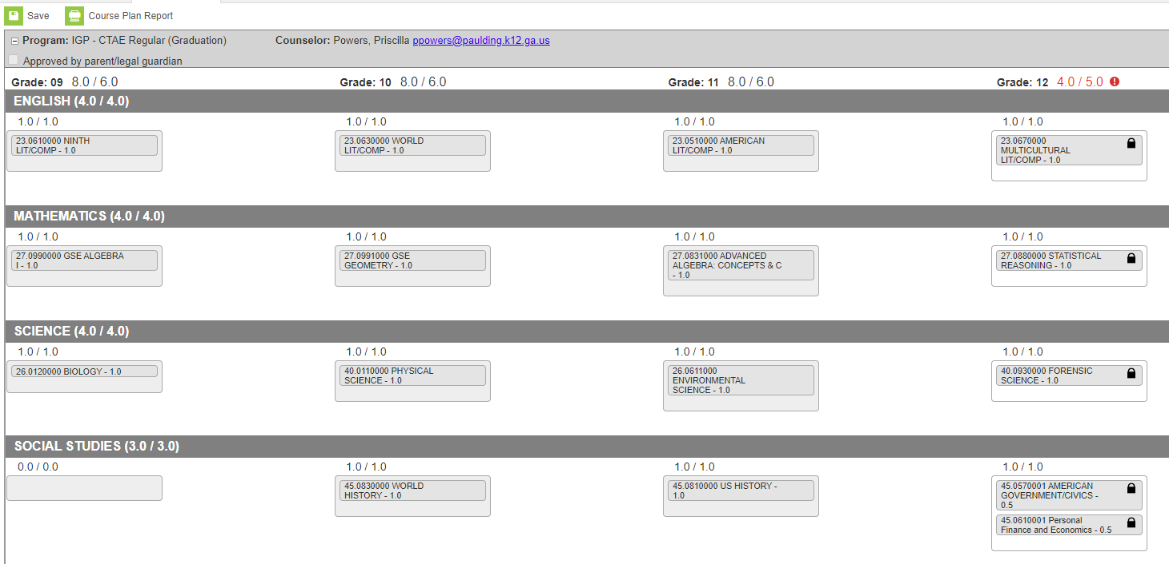
Academic Planning

Slide 9
Honors/AP
Students who take an Honors course earn 5 additional bonus points on their final grade when passed with a 70 or higher.
Students who take an AP course earn 10 additional bonus points on their final grade when passed with a 70 or higher.
As a reminder – the HOPE program removes bonus points awarded
Teacher recommendations are happening now
Teachers of core subjects recommend students for next year’s classes; these will be finalized by the end of Aril
To see your student’s future classes, log in to your parent account on Infinite Campus and select “Academic Plan”
Honors/AP Waiver – Students who wish to change the level of their academic (core) classes should see their counselor before May to make this change
There is no guarantee that students will be able to change levels during Schedule Changes in August!

Slide 10
The Hope Scholarship
An opportunity for students to earn tuition toward college courses after they graduate from high school
Can be applied to four-year and two-year colleges, as well as private colleges
Students must attend a Georgia college for funding availability
HOPE GPA (grade point average) and high school GPA are NOT the same!
3.0 HOPE GPA in your core classes over all 4 years
Student will be able to view their HOPE GPA through their GA Futures account.
Students create this account on their own during the freshman year of high school. → gafutures.org

Slide 11
GA Futures is the website you will use to monitor your Hope GPA. At the end of each semester, when final grades are posted to your transcript, students will be able to log into their GA Futures account and view their HOPE GPA.
Students will create this account on their own. They will need to enter their legal information including their social security number to display the HOPE GPA.
Ga Futures is your go to website to learn all about the HOPE scholarship, look for scholarships, apply to colleges, and so much more!
www.gafutures.org

Slide 12
A quick note on Athletics
Did you know…
Eligibility – 2.5 credits (3 classes with a grade above a 70) each semester
This is a Georgia High School Association (GHSA) guideline that is followed by all Georgia high schools.
Students must be on-track to graduate and in their cohort grade level
Students will need a physical on file with North Paulding High School to participate in workouts, conditioning, and tryouts
Some sports begin conditioning in the summer

Slide 13
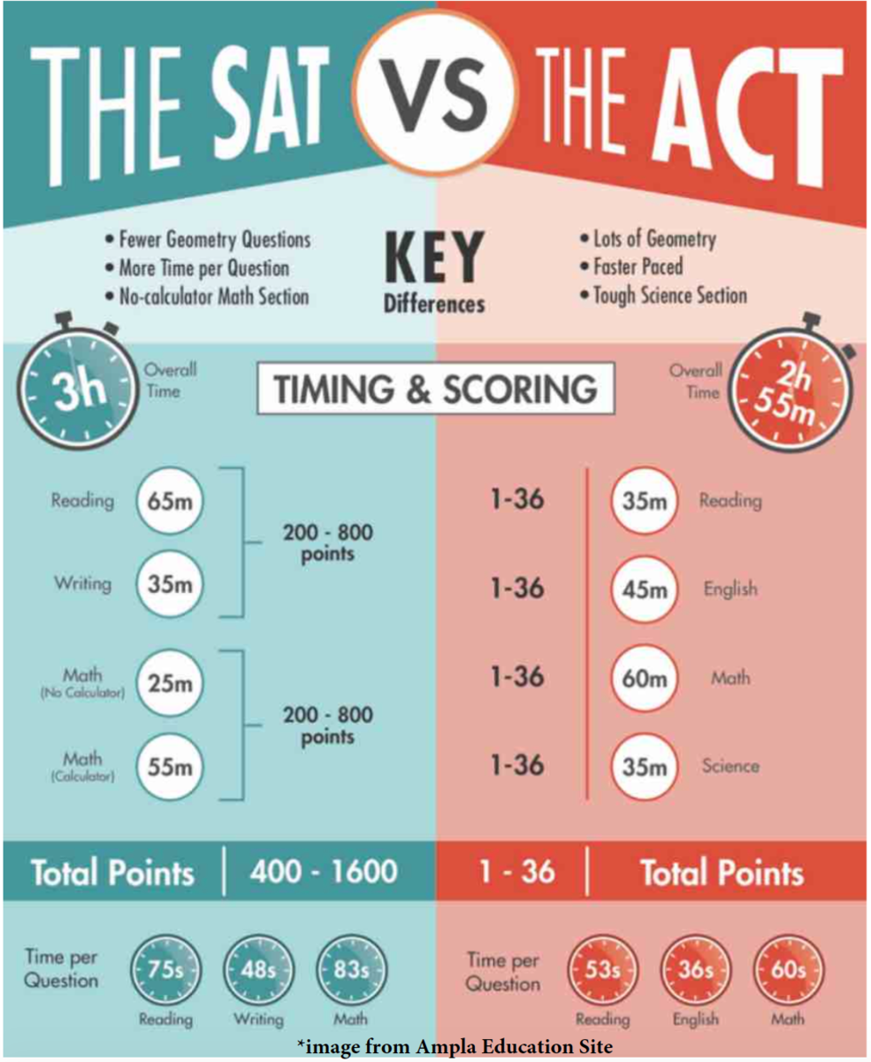
PSAT, SAT, & ACT – oh my!
All 10th Graders were given the opportunity to take the PSAT in October
Results from this test can be found on the College Board website: https://satsuite.collegeboard.org/psat-nmsqt/scores
Does my student need to take the SAT?
If your student plans on enrolling in a 4-year or 2-year college after high school, they will likely need to take an achievement test like the SAT: https://satsuite.collegeboard.org/sat
What about the ACT?
Every college/university requires different admissions criteria. Find dates and sign up here: https://www.act.org/content/act/en-georgia.html

Slide 14
Testing
ASVAB (Armed Services Vocational Aptitude Battery)
A standardized test that reveals areas of strength and ability in science, math, and language
10th-12th Grade students only
Taking this test is one of the first steps before a student may enlist in any branch of the military
A great resource if you don’t know what you would like to do after high school! Not just for military.
10 subjects
The ASVAB is FREE and test administration will be held here at North Paulding.
Wednesday, March 8 in the Media Center
Sign up in the Counseling Office
YouScience Summit
Taken by all 10th grade students, this is a career aptitude test that measures a variety of skills and abilities to generate jobs at which students are likely to be successful.
Please visit Chorus Room for more information
End of Course (EOC) Tests
Required for all students
Count for 20% of a student's final grade
State mandated
Cannot be exempted
Algebra I
Biology
American Literature
United States History

Slide 15
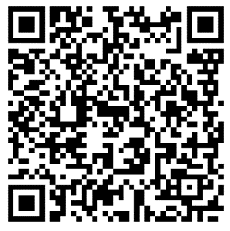
Paulding College & Career Academy (PCCA)
PAULDING VIRTUAL ACADEMY (PVA)
Serves all 5 high schools in Paulding County.
Programs are housed at New Hope Education Center
Transportation is provided to and from NPHS for classes.
Offers courses and pathways specifically selected based upon the work needs of the surrounding area and the state.
For a fully online experience, please register your student in Infinite Campus Parent Portal by February 16, 2024.
Please note that this is a yearlong commitment.
PCCA Interest Form:
Pathways Offered
Healthcare
Mechatronics/Manufacturing
Energy
Cybersecurity

Slide 16
Dual Enrollment (Presentation in Theatre)
For Juniors and Seniors
Students can take courses from a state public or private college while still enrolled as a high school student and receive credit both at the high school and at the postsecondary institution.
Most college classes (up to 30 hours) are free for high school students.
Expand course offerings
Save money on college.
Get ahead on college coursework.
Flexible schedule.
Quicker entry into the workforce.
Important Considerations:
Maturity Level
Transportation
We cannot guarantee a parking pass
Must be off campus when not in class at NPHS
Admission requirements are different for each college

Slide 17
Questions?

Slide 18
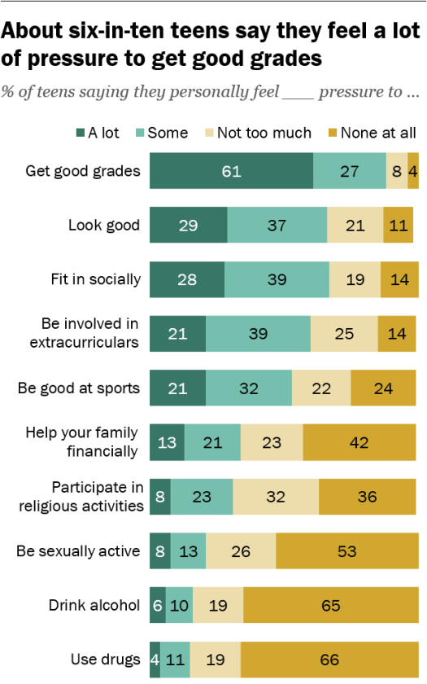
Common Student Stressors
COVID-19 changed our whole world
9th and 10th grade students missed crucial social opportunities during lockdown
Pressure to succeed
Burn out is more common than ever!
Negative world news
Social media
Students’ brains are still developing
The decision-making center is the last to develop
Pew Research Center, 2018

Slide 19
Warning Signs
“As a parent/guardian, what should I be looking for in my teen’s mood/behaviors/words to know that they may not be doing okay?”
Loss of interest in hobbies or activities
Withdrawal from friends and family
Sudden poor school performance (not due to sickness)
Fatigue and/or restlessness
Unexplained aches and pains
Changes in eating or sleeping habits
Excessive cell phone use (outside of normal use)
No plans for their future or lack of interest in finding a passion

Slide 20
How can you help?
Start the conversation!
Listen if they open up to you about their struggles and emotions
Speak candidly about your concerns for their health and well-being
Do not try to solve every single one of their problems for them
Reach out to your student’s school counselor if you are not sure how or where to get them help
Make an appointment with their pediatrician if necessary

Slide 21
Cell Phones – Good or Bad?
Pros
Constant communication
Many teachers use cell phones in class
Reminders and calendar use
Tools for success
Fit in with friends and peers
You can block unfriendly content
A great way to educate teens about internet safety
Cell phones are not going away!
Cons
Constant communication
Can be a distraction in class
Notifications can get out of hand
You cannot monitor every little thing they do or say
Cell phone addiction is possible
Social media can add to stress
Sleep habits may be affected
Cyber bullying is a possibility

Slide 22
In conclusion
Questions:
We are on the same team!
Infinite Campus and Canvas – Parent Portal
Pay attention to your teen’s behavior
Don’t be afraid to ask a school counselor
NPHS Counseling Website:
gonphs.weebly.com

Slide 23
NPHS School Counselors gonphs.weebly.com
Mrs. Beauseigneur – Students last names A-B
Ms. Powers – Students last names C-E
Mrs. Keefe – Students last names F-H
Mrs. Harris – Students last names I-Ma
Ms. Whitfield – Students last names Mb-Po
Mrs. Pinckney– Students last names Pr-S
Mrs. Willis – Students last names T-W
Submit questions here:

Slide 24
Counselor Contact

