Slide 1
Freshman Class of 2026 Counselor Meeting

Slide 2
Topics
Graduation Requirements
Understanding Academic Recommendations for Next School Year
Special Programs
Elective Registration
Bridge Bill
Health Survey

Slide 3
Graduation Requirements
Students must complete and pass 23 classes to graduate per the Georgia Department of Education. These credits must be earned in specific subject areas.
4 credits in English
4 credits in Math
4 credits in Science
3 credits in Social Studies
1 Personal Fitness and Health or 3 credits in JROTC
3 credits in CTAE/Fine Arts/World Language
4 Electives

Slide 4
Understanding Academic Registration
Each semester, your teachers make course selections for you based on how you performed in their classes that semester.
For fall semester, this was done at the end of the semester. For this semester, teachers will be making recommendations mid-February.
Many times, teachers will have discussions with the students about their recommended placement.
Please take an active role in your education by asking questions. You and your parents/guardians will be able to view your recommended courses in your Academic Planner on Infinite Campus in April. Your academics should not be a surprise in August when you get your schedule.
In April, you may request changes by communicating with your Counselor.
All changes need to be made by the end of April so we can allot our teachers and classes for next school year.

Slide 5
Academic Registration
Students will typically take the following academic classes for 10th grade year:
English: World Literature or Honors World Literature. Students who are currently taking World Literature will take Honors American Literature or American Literature
Math: Geometry or Honors Geometry. Students who are currently taking Honors Geometry will take Honors Algebra II or Algebra II (non-honors).
Science: Physical Science, Chemistry, or Honors Chemistry.
Social Studies: World History. Honors World History, or AP World History
As a reminder, if you failed a course required to graduate, you will need to take the failed course in summer school (more information to come) or you will need to take it next school year and double up in that subject area.

Slide 6
Honors/AP
Students who take an Honors course earn 5 additional bonus points on their final grade when passed with a 70 or higher.
Students who take an AP course earn 10 additional bonus points on their final grade when passed with a 70 or higher.
As a reminder – the HOPE program removes bonus points awarded.
If you want to take an Honors or AP course and your teacher did not recommend you for the course – please see a counselor to complete an Honors/AP waiver.
If your teacher recommends Honors/AP and you do not want to take this level, you need to let your counselor know before the end of April for scheduling reasons.
There is no guarantee you may drop your Honors or AP course if the on-level course is full come August. Please select your academics and electives wisely.

Slide 7
Academic Planner
As mentioned in a previous slide, students will review their courses to ensure the academics and electives that are entered in their academic planner are correct.
Counselors will email parents when all registration has been completed. During this time, students and parents must review this information. Counselors will also send out reminders to students through Canvas to check their academic planner. Be sure you are reviewing these messages.
Students will not be able to make a change to the academic planner through Infinite Campus. You will need to email your assigned high school counselor and request a change be made.
Again, all changes must be completed come end of April 2023.
Helpful Hint: Add a reminder to your calendar and set a notification to check your academic planner by April 10th.

Slide 8
Athletics
Students are offered the opportunity to play a sport in high school. Each high school has various sports students may try out for. Be sure to contact the head coach of each sport and ask about conditioning and tryout information.
Some teams begin conditioning in the summer.
Students will need a physical on file with North Paulding High School to participate in workouts, conditioning, and tryouts.
Did you know…
To play sports in high school students must earn 2.5 credits each semester to be eligible to play. This is a Georgia High School Association (GHSA) guideline that is followed by all Georgia high schools.
Also, students must be on-track to graduate and in their cohort grade level

Slide 9
GA Futures
Gafutures is the website you will use to monitor your Hope GPA. At the end of each semester, when final grades are posted to your transcript, students will be able to log into their GA Futures account and view their HOPE GPA.
Students will create this account on their own. They will need to enter their legal information including their social security number to display the HOPE GPA.
Ga Futures is your go to website to learn all about the HOPE scholarship, look for scholarships, apply to colleges, and so much more!
www.Gafutures.org

Slide 10
HOPE Scholarship
The HOPE Scholarship is an opportunity for students to earn tuition toward college courses after they graduate from high school.
The HOPE scholarship can be applied to four-year and two-year colleges, as well as private colleges. Students must attend a Georgia college for funding availability.
The HOPE GPA (grade point average) and your high school GPA are NOT the same!
The Hope Scholarship only calculates your GPA for core courses and World Language (English, Math, Science, Social Studies, and World Language).
By law, the HOPE GPA does not round
If a student takes an honors course, the 5 additional bonus points are removed for the students HOPE GPA calculation.
If a student takes an AP course, the 10 additional bonus points are removed for the students HOPE GPA calculation. However, the Hope program does award .5 points back to the HOPE GPA calculation.
High school courses taken in middle school are not calculated in a students' HOPE GPA.
Student will be able to view their HOPE GPA through their GA Futures account. Students create this account on their own during the freshman year of high school.

Slide 11
HOPE Scholarship Cont.
Qualifications for HOPE (covers a portion of your public or private college tuition):
3.0 HOPE GPA
4 Rigor Courses
No SAT or ACT requirement to receive HOPE
Qualifications for Zell Miller Scholarship (covers 100% college tuition for a public college, and a portion for private college)
3.7 HOPE GPA
4 Rigor Courses
SAT Score -1200 (composite)
ACT Score – 26 (composite)
Please visit the GA Futures website to learn more about the Hope Scholarship
WWW.GAFUTURES.ORG

Slide 12
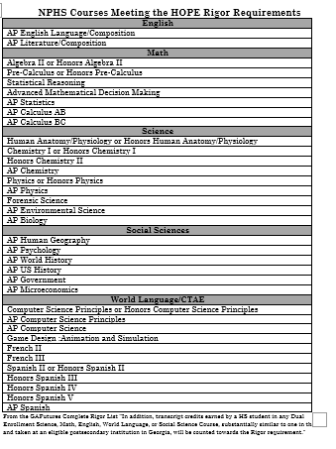
The courses listed on this slide are current NPHS classes that are considered rigor with GA Futures.
To view the full list of all rigor courses students should visit the GaFutures website:
https://www.gafutures.org/media/hvnjflju/rigor-list-january-2023-print-ready.pdf

Slide 13
End-of-Course Assessment
(EOC)
EOC’s are end of course assessments that will count for 20% of a student's final grade. These are state mandated tests.
Courses with EOC’s are Algebra I, Biology, American Literature, and US History.
EOC’s cannot be exempted, unlike teacher finals.

Slide 14
Special Programs
Available through Paulding County School District and North Paulding High School

Slide 15
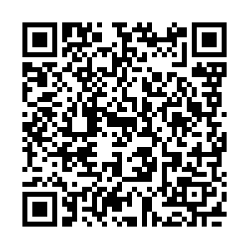
Paulding College and Career Academy (PCCA)
Pathways Offered
Healthcare
Dual Enrollment Opportunities
Certified Nursing Assistant Opportunity
Patient Care Technician Opportunity
Mechatronics/Manufacturing
Electronics, Computers/drafting, Robotics
Dual Enrollment Opportunities
Energy
Lineman/Technician
Cybersecurity
Dual Enrollment Opportunities
IT
DELL Certificate
Serves all 5 high schools Paulding County.
Programs are housed at New Hope Education Center
Transportation is provided to and from NPHS for classes.
Offers courses and pathways specifically selected based upon the work needs of the surrounding area and the state.
SCAN QR code if interested in going to PCCA Fall 2023 or Spring 2024

Slide 16
Online Opportunities
Online at NPHS
Online at Home with Paulding Virtual Academy
Is there a course not offered at NPHS that you would like to take?
Did you fail a class and want to recover it online instead of in a class?
Would you prefer to take an online class during the school day in a lab setting?
These opportunities are available for you. Talk to your counselor about how to do this.
For a fully online experience while remaining a North Paulding student, applications for Paulding Virtual Academy will close March 3, 2023.
Please note that this is a yearlong commitment.
Students who want to take a new credit course online should complete the SB 289 application available in April on the PCSD website.

Slide 17
Elective Registration

Slide 18
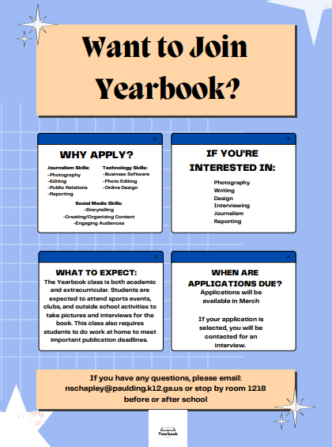
Electives with Applications: Journalism

Slide 19
Yearlong Electives
If you sign up for the following electives, you are making a yearlong commitment.
Band
Chorus
JROTC
Journalism

Slide 20
Required Electives
Health and Personal Fitness are not electives. Every student must take Health and Personal Fitness to meet graduation requirements.
The only exception to this rule is for JROTC students. You must successfully complete 3 semesters, earning 3 credits, in JROTC to exempt the Health and Personal Fitness Requirement.
If you have not had Health, Personal Fitness or JROTC, please contact your counselor.
World Language – You do not have to take a world language to graduate. However, you do need 2 years in the same language to enter most four-year colleges.
Example: Spanish 1 & 2 or French 1 & 2. Not Spanish I and French I.

Slide 21
To Read Course Descriptions, Scan the QR Code
Students may also visit the link below from our counseling link:
https://gonphs.weebly.com/course-descriptions.html

Slide 22
Elective Registration Link
Visit the counseling website at www.gonphs.weebly.com
Find the Google Link under Elective Registration on the main page.
Complete only one entry. If you need to make a change to your elective requests, you need to email your assigned counselor. By entering more than one entry, may cause confusion for your schedule next school year.
Students will choose EIGHT (8) elective courses/pathways below. Rank the courses in order (first choice is selection 1, second choice is selection 2, etc.).
Don’t forget your World Language if you plan to attend a 4-year college. This should be your first elective choice.

Slide 23
BRIDGE BILL FRESHMAN
DUAL ENROLLMENT
SELECT THREE CAREERS

Slide 24
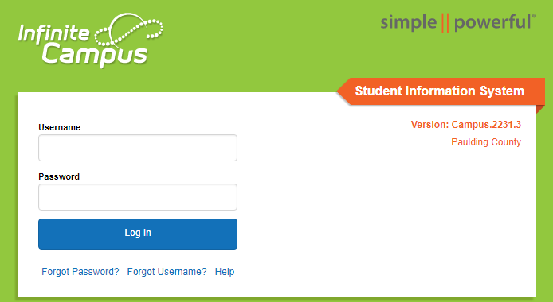
STEP 1
Using Google Chrome -- Login to Your Infinite Campus Account at
Campus.Paulding.k12.ga.us

Slide 25
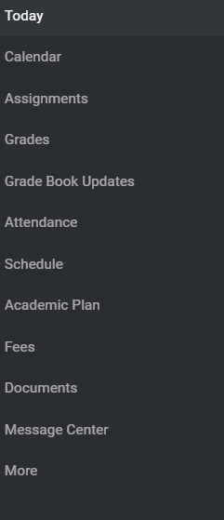
STEP 2
On your Infinite Campus Portal Page
Click on MORE (Left-Hand Side)

Slide 26
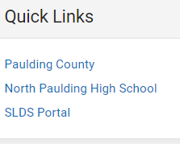
STEP 3
Click on the blue SLDS Portal Tab (Right side of the page)

Slide 27
STEP 4
Click on My Career Plan Box

Slide 28
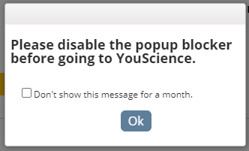
STEP 5 & 6
Click on the Go To YouScience Tab
Click on the OK Button for the Pop Up Blocker

Slide 29
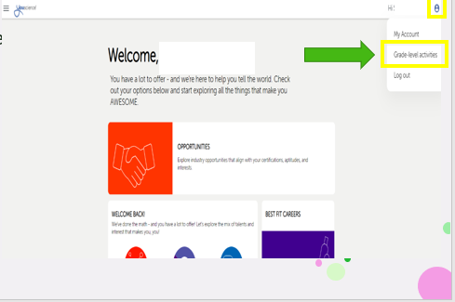
STEP 7
Make the Next Page – Full Screen
Go To the Top Right Corner
Click on the Blue Circle
Then Click on Grade-Level Activities

Slide 30
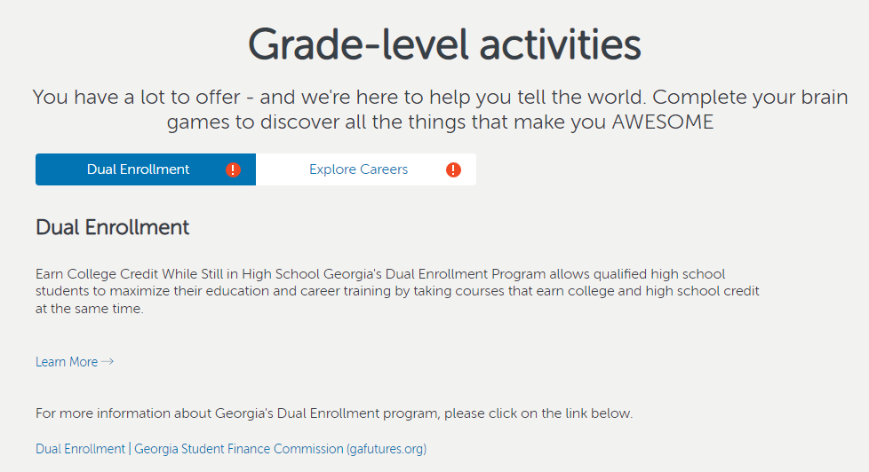
STEP 8
Highlight Dual Enrollment Tab
Click on Learn More
Review the Dual Enrollment Page for Information

Slide 31
STEP 9
When you have finished reviewing the dual enrollment information –
Click the X on the tab to exit the activity
This will take you back to the My Career Plan
Click on the Go To YouScience Tab and then OK

Slide 32
STEP 10
This brings you back to the beginning
Make the Page – Full Screen
Go To the Top Right Corner
Click on the Blue Circle
Then Click on Grade-Level Activities

Slide 33
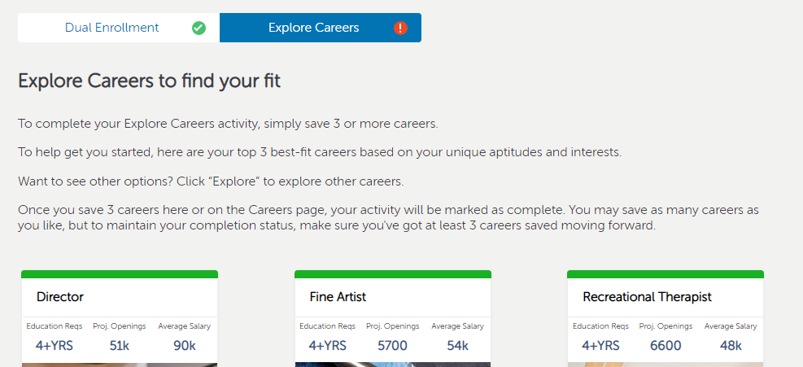
STEP 11
You should see the Dual Enrollment Tab has a green checkmark
Highlight the Explore Careers Tab
Read Instructions – Then Click the Green Explore Tab

Slide 34
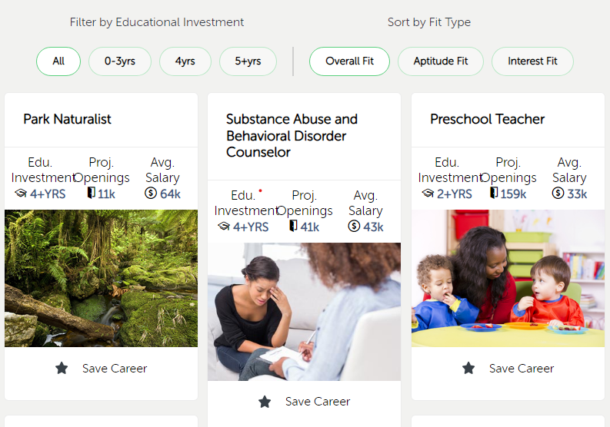
STEP 12
Explore All Careers or filter by Years Spent in College or Your Fit Type
Click on the Star Button if you are interested in that Career
You will need to choose and save 3 different careers
You Have Completed this Activity when the Saved Careers Tab shows 3 more Saved Careers (Some of you may have saved careers from 8th grade)
*This is an example of saved careers from Middle School – *You must save 3 more to complete the activity – making it a total of 5 careers for this student
*Some of you may have 3 saved careers from Middle School – making it a total of 6 saved careers to complete the activity.

Slide 35
STEP 13
Go Back to You Science Home
You will have completed the Freshman Bridge Bill State Requirements when the following Grade-Level Activities have a Green Checkmark
Dual Enrollment
Explore Careers

Slide 36
Health Survey When you have completed all tasks, please take the anonymous health survey (student) www.gonphs.weebly.com (main page)

Slide 37
Counselor Contact

